Slide 1



IT Whizzes
Group register
Digital Leaders - Miss Jones Year 5
Layla Bond
Myiesha Thomas
Korban Lee Howells
Lola Lewis
Imogen Lloyd
Madison Owens
Joshua Colin
Lexi Hicks
Tulisa Williams
Chelsea Coelho
Lacie Davies
Amelia Grant
Macauley Howells
Layla McCarthy
Samara McGovern
Lois Stibbs
Andrei Sutu
Brayden Williams
Jak Williams
Lexie-Mae Gregory
Ysgol Gynradd Goetre

Slide 2
IT Whizzes
Name of our group -
IT Whizzes
Chairperson – Andrei Sutu - Year 6
Vice Chairperson – Brayden Williams – Year 6
Secretary – Chelsea C - Year 6
Minute taker – Imogen Lloyd – Year 5
Ysgol Gynradd Goetre

Slide 3
IT Whizzes
Week 1:
Designed a logo
First things we need to do in the new school year:
To make sure children are using chromebooks in class.
Teach children progammes that we like.
Make sure all children know how to play Minecraft
Maybe have an expert to teach different things eg Expert of ‘Scratch’ etc.
Ysgol Gynradd Goetre

Slide 4
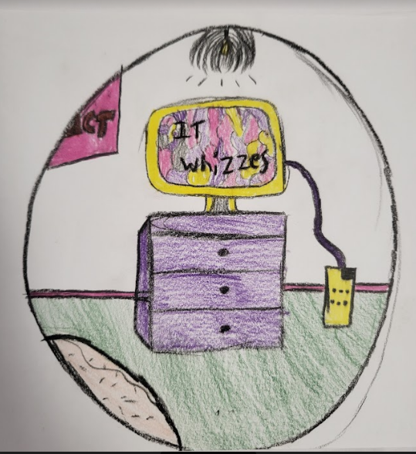
IT Whizzes
Our New logo
Ysgol Gynradd Goetre

Slide 5
IT Whizzes
Week 2:
To create tutorials for all the programs we use
We thought about using Minecraft coding, online safety, cartoons for little kids and maybe doing a Fifa tutorial.
Ysgol Gynradd Goetre

Slide 6
IT Whizzes
Week 3: Children wrote an email to Technocamps We decided we wanted to make videos about topics that help us. We thought about creating videos for: Maths videos - subtracting, science videos, adjective videos, which will be created by us. We will begin to make these next time.
Ysgol Gynradd Goetre

Slide 7
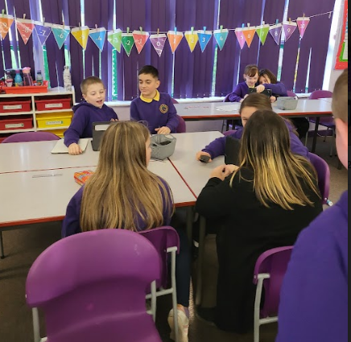
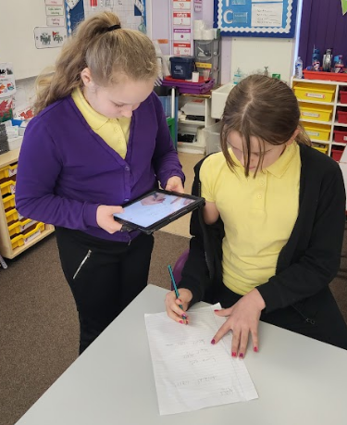
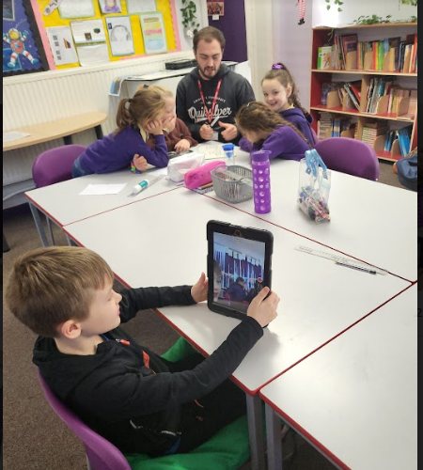
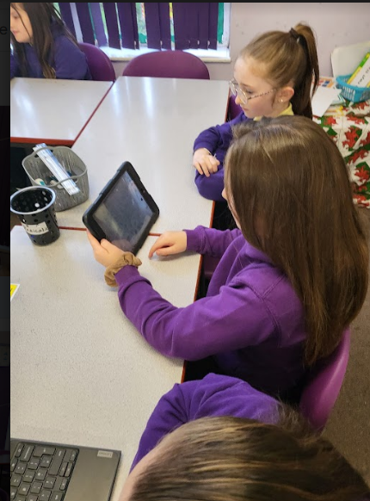
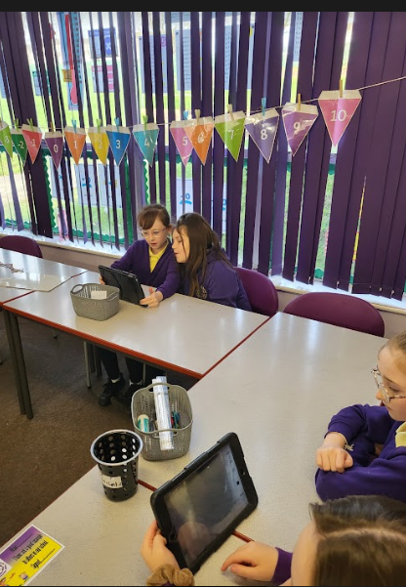
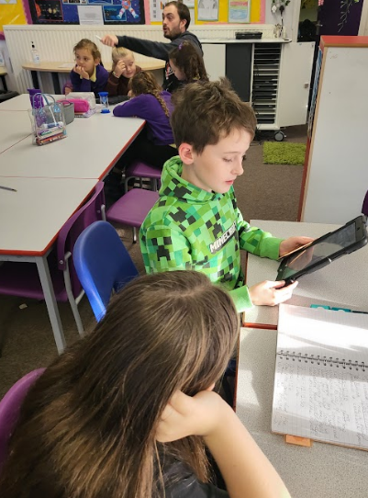
IT Whizzes
Ysgol Gynradd Goetre

Slide 8
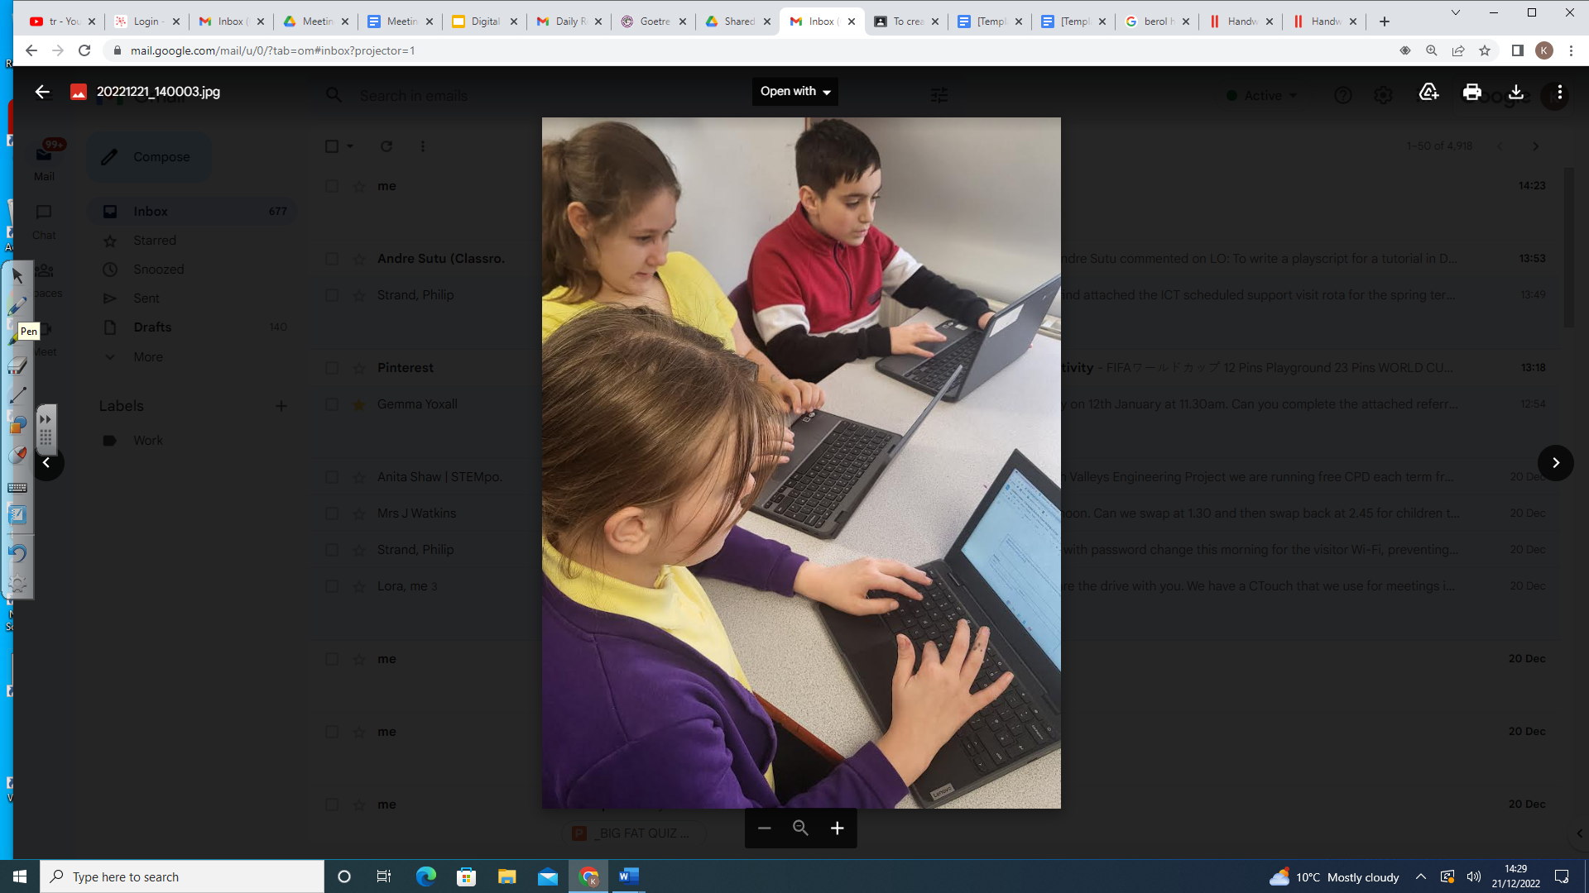
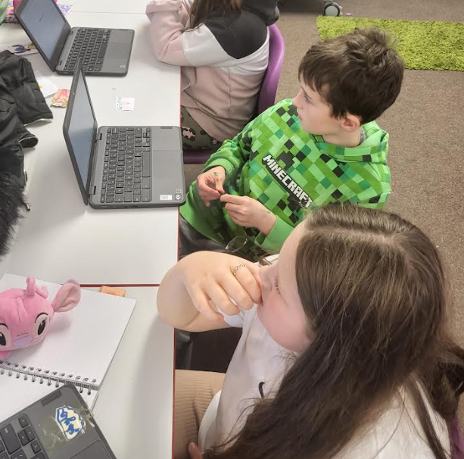
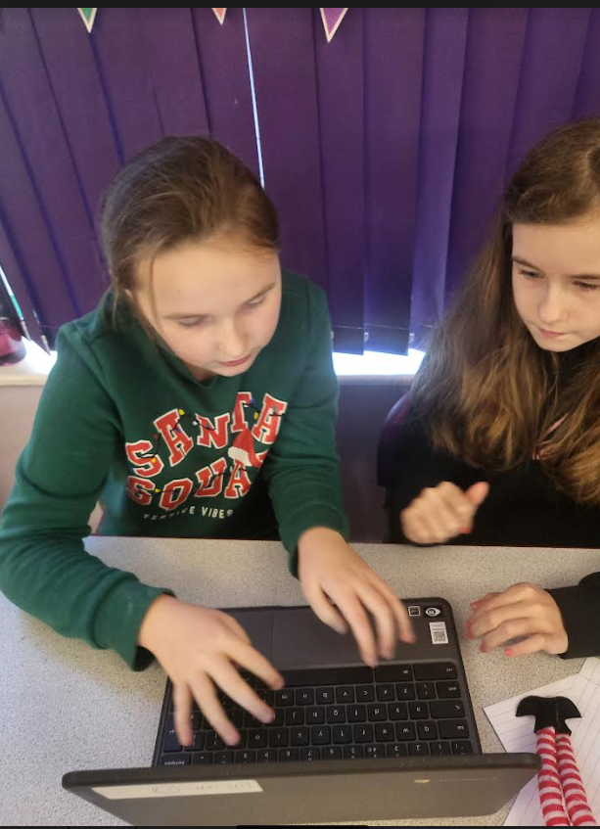
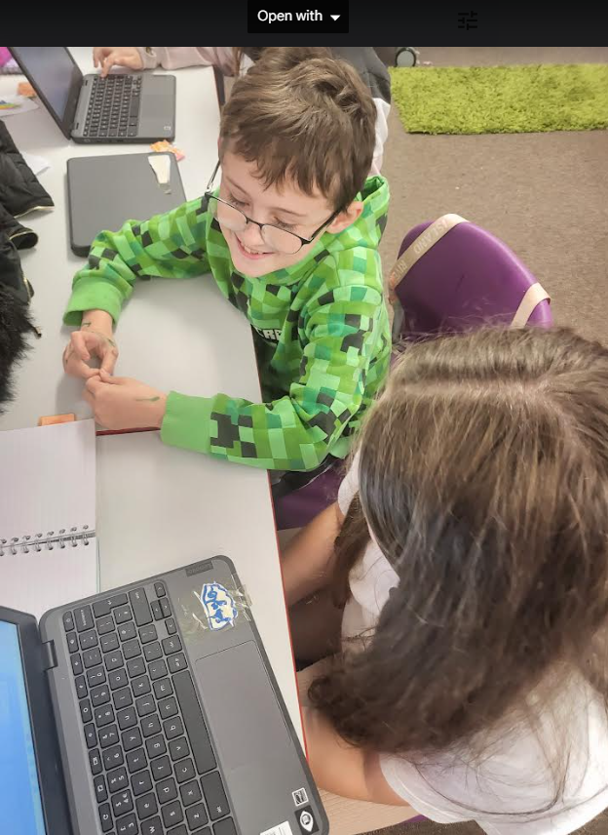
Digital Leaders
Week 4: We started to make scripts for tutorials for children for handwriting
Ysgol Gynradd Goetre

Slide 9
Digital Leaders
Week 4: We started to make scripts for tutorials for children for handwriting
Ysgol Gynradd Goetre

Slide 10
Digital Leaders
Ysgol Gynradd Goetre

Slide 11
Digital Leaders
Ysgol Gynradd Goetre

