Slide 1

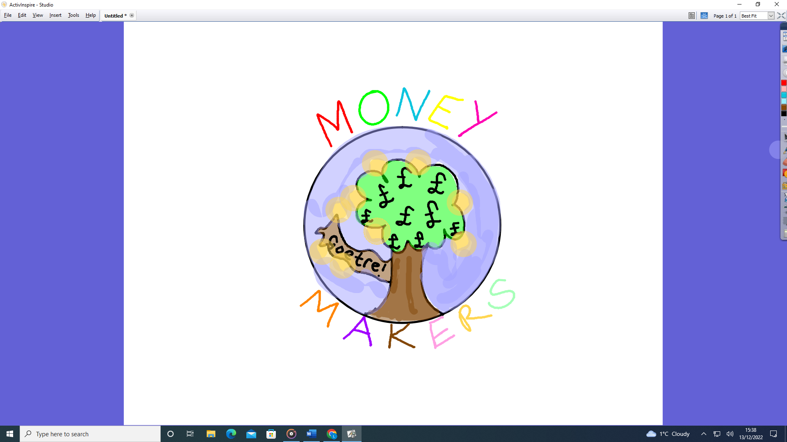

The Money Makers
Our Aim: To help raise essential funds for our school. To invest in good projects and develop our entrepreneurial skills.
Ysgol Gynradd Goetre

Slide 2
The Money Makers
Possible name of our group -
Money Makers The Apprentices Dollar Takers Fund Raisers
Final name choice - The Money Makers
Chairperson - Rio Evans Year 6
Vice Chairperson - Alfie Lindey Year 6
Secretary - Lacey Jones Year 6
Ysgol Gynradd Goetre

Slide 3
The Money Makers
Members/Register:
Year 3 : Elliot Wood, Harri Williams, Leo Webber, Teejae Stapleton, Renesmee Powell-Hodges, Ollie O’Sullivan, Isla Jones, Jacob Davies, Ethan Hartles, Jenson Thomas, Rory Lewis, Lucas Evans, Iylah Beynon.
Year 4: Layla Jones, Ivy Power, Ruby Wickens
Year 5: Reegan Thomas. Lilli-Rae Williams, Amelia Morris, Rylan Davies, Jenson Hoare
Year 6; Lacey Jones, Lucas Hellyer, Rio Evans, Alfie Lindsay
Ysgol Gynradd Goetre

Slide 4
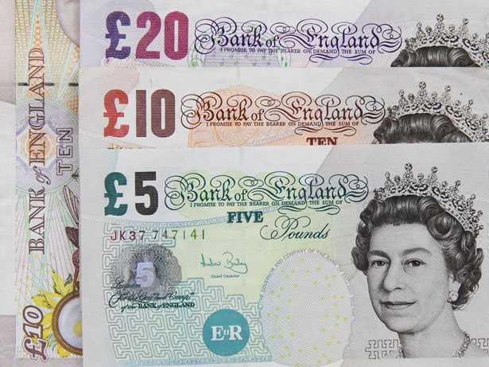
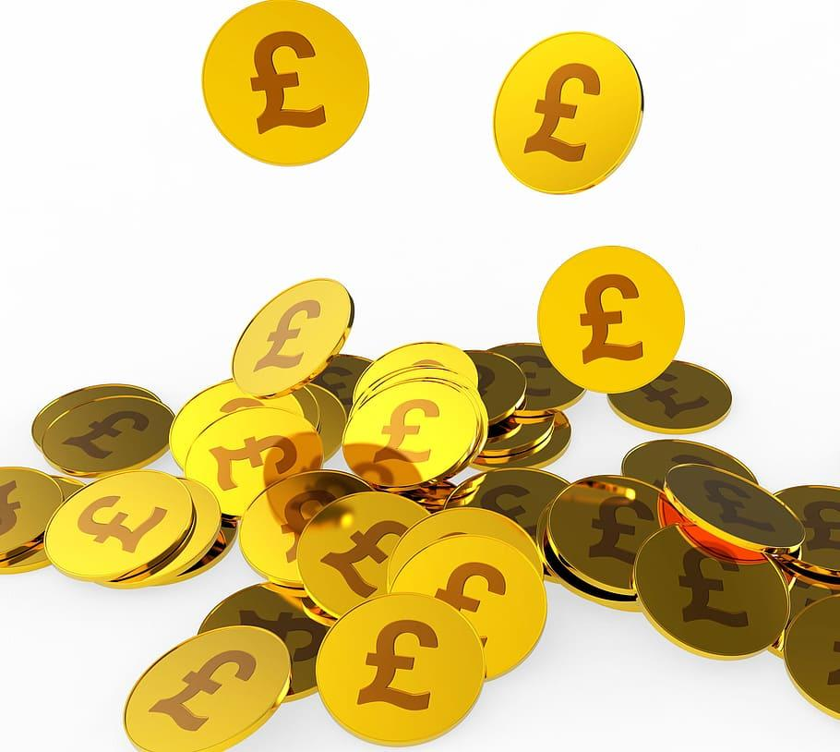
The Money Makers
Our Logo:
Designed by:
Rylan Davies Year 5.
Ysgol Gynradd Goetre

Slide 5
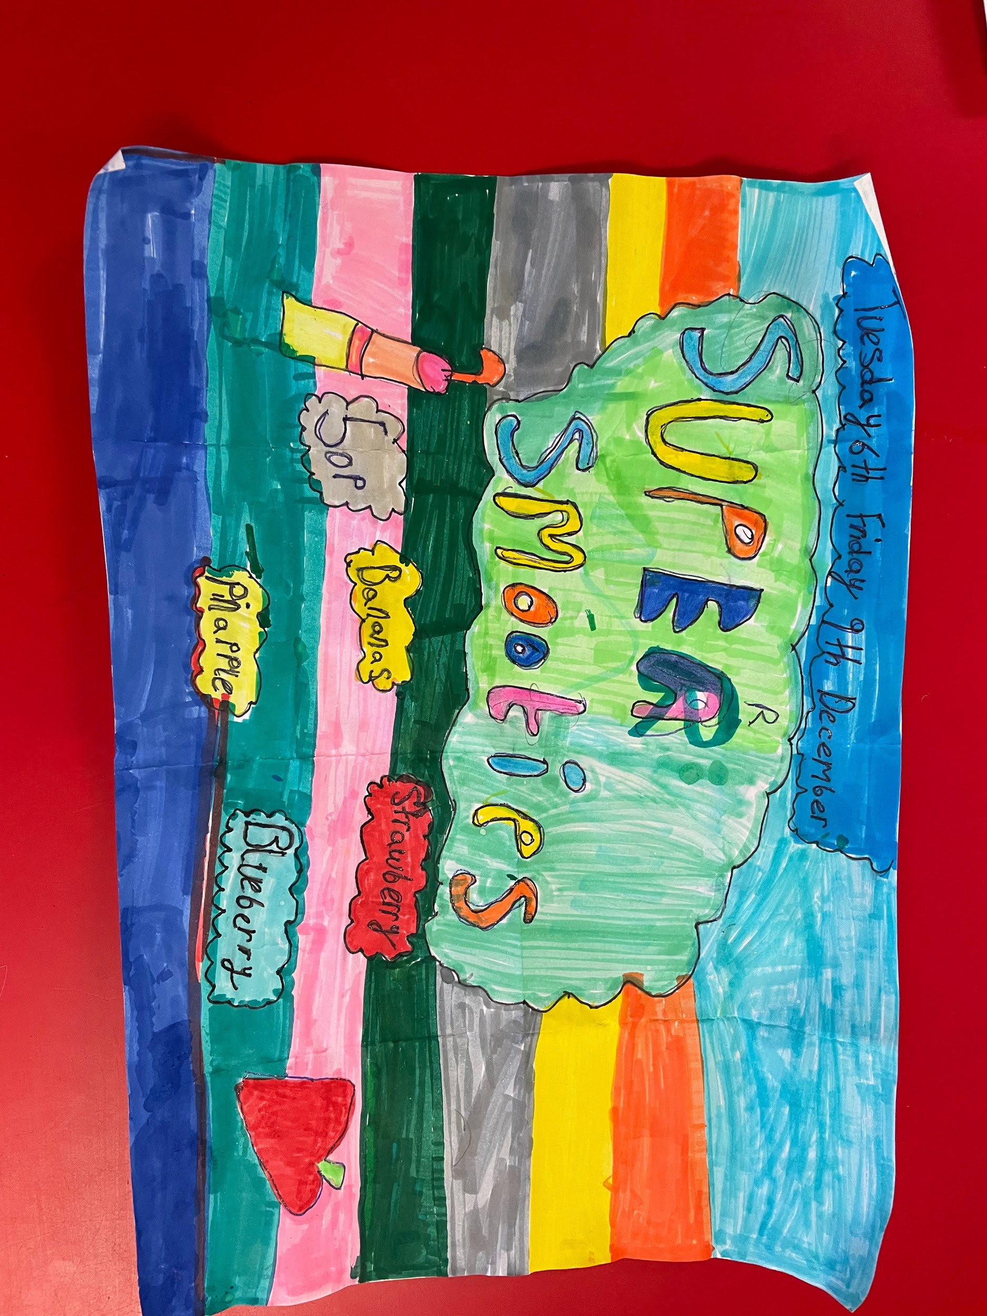
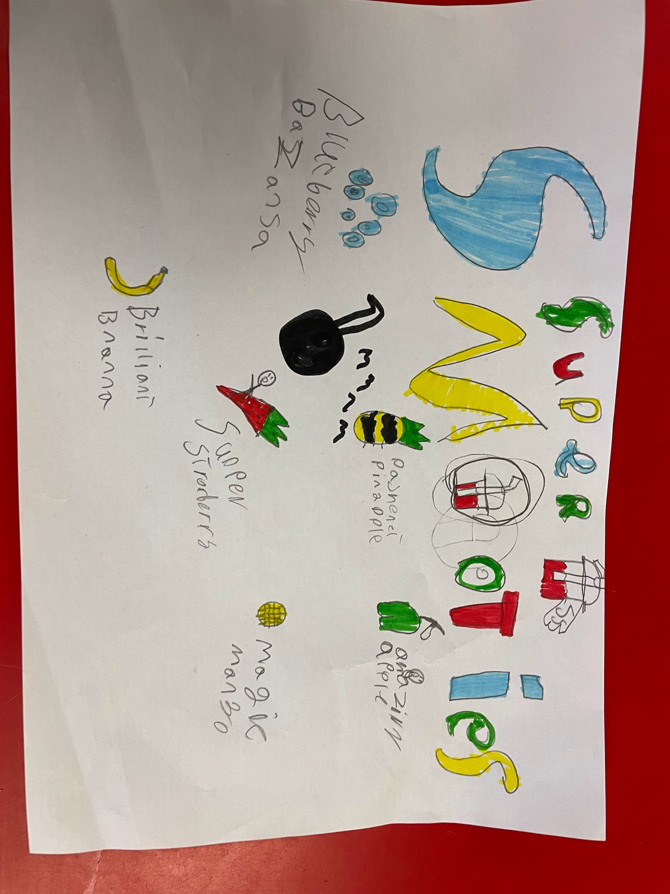
The Money Makers
Ysgol Gynradd Goetre

Slide 6
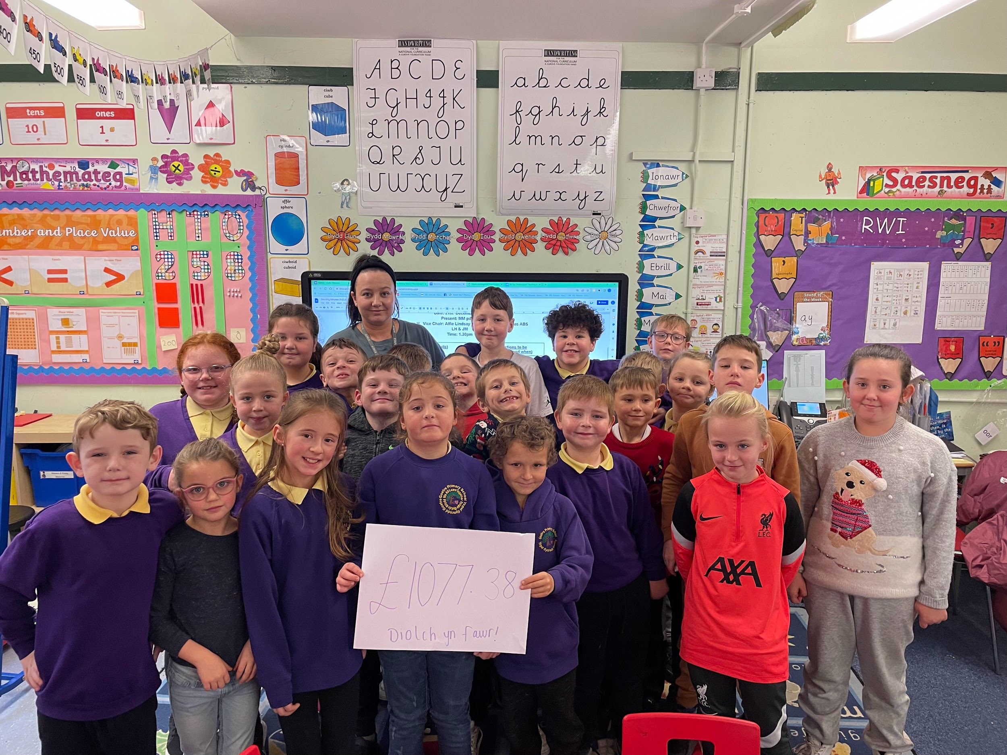
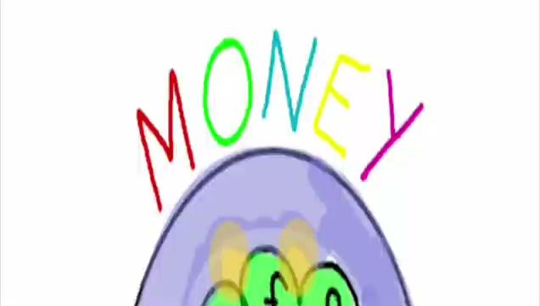
The Money Makers
Ysgol Gynradd Goetre

Slide 7
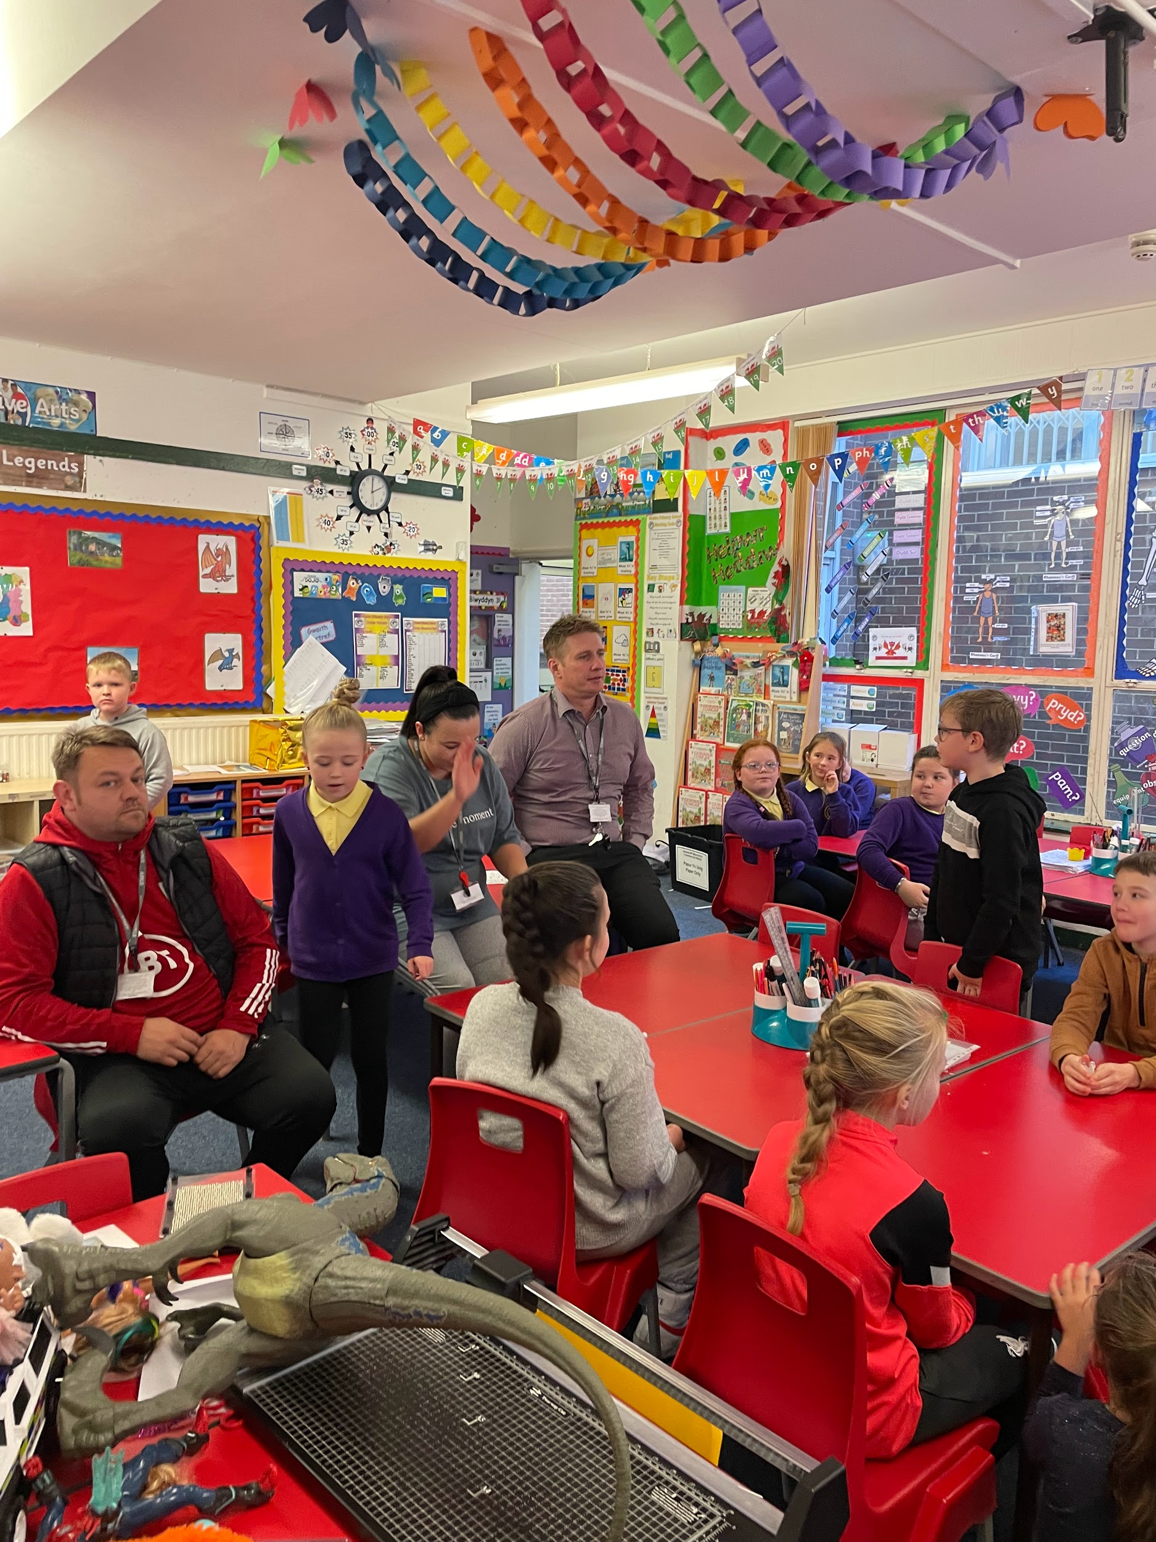
The Money Makers
Ysgol Gynradd Goetre

Slide 8
The Money Makers
Ysgol Gynradd Goetre

Slide 9
The Money Makers
Ysgol Gynradd Goetre

