Slide 1
Safety Squad
Road Safety Assembly

Slide 2
Who are we?
Notes:
We are the Safety Squad. Our chair person is Macey Hill and our vice chair is Lily-Mae Plaine.

Slide 3
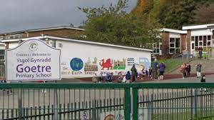
What are our aims?
We want to make Goetre school a safe and secure place.
We want to make the school grounds safe.
For all pupils, staff and visitors.

Slide 4
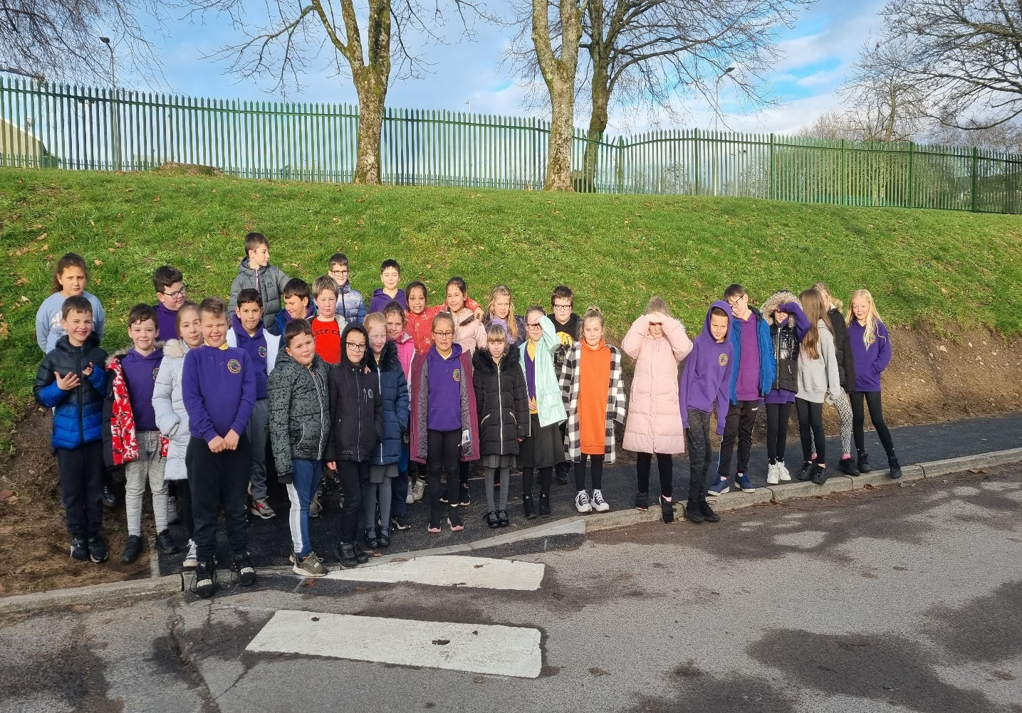
What have we done so far?
We spoke about having a new path built so no one has to walk on the drive way.
We talked about having safer crossings for pupils to cross the drive safely.
Notes:
We spoke about having a new path built so no one has to walk on the drive way. Because of the lack of pavement, anyone walking into the school had to walk on the drive which put them at risk of being hit by a car. A new pavement has been put in from the middle gate to make a safer place for people to walk without the risk of being hurt by a car or delivery van driving up the driveway.
We talked about having safer crossings for pupils to cross the drive safely. Zebra crossings have been painted on the drive in 2 places to make crossing the drive safer for anyone walking into school.
We discussed how there was no fencing around the car park. This made it very unsafe when cars were driving into or parking, as visitors and pupils could walk through the car park. A new fence has been put in around the car park, and also around the junior yard. This also stops children running up from the yard and into the car park or along the drive.

Slide 5
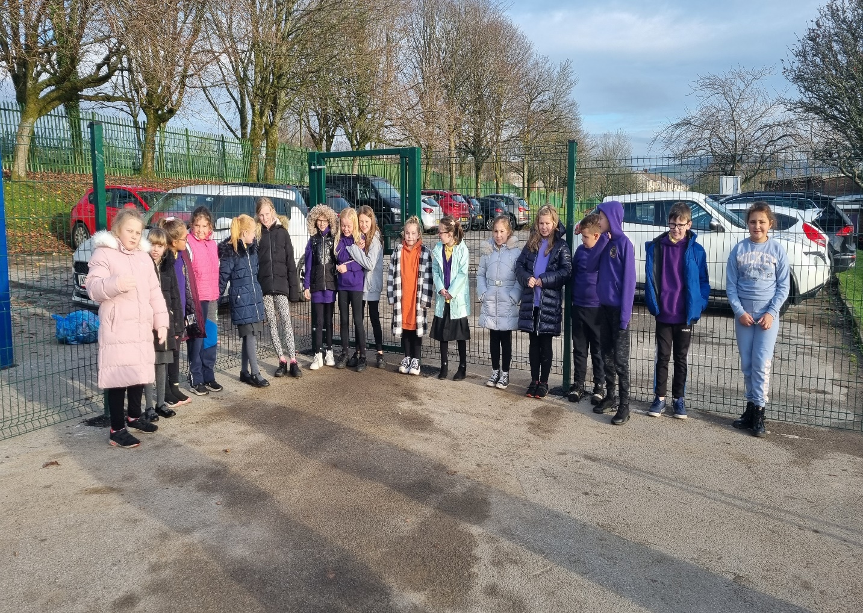
What have we done so far?
We discussed how there was no fencing around the car park and junior yard.
We talked about how the infant yards fence was very low and dangerous.
Notes:
We spoke about having a new path built so no one has to walk on the drive way. Because of the lack of pavement, anyone walking into the school had to walk on the drive which put them at risk of being hit by a car. A new pavement has been put in from the middle gate to make a safer place for people to walk without the risk of being hurt by a car or delivery van driving up the driveway.
We talked about having safer crossings for pupils to cross the drive safely. Zebra crossings have been painted on the drive in 2 places to make crossing the drive safer for anyone walking into school.
We discussed how there was no fencing around the car park. This made it very unsafe when cars were driving into or parking, as visitors and pupils could walk through the car park. A new fence has been put in around the car park, and also around the junior yard. This also stops children running up from the yard and into the car park or along the drive.
We talked about the fences around the infant yard. Even though it stopped children from running out on to the drive, it was dangerous because it was very low, and any child climbing up on the fence could hurt themselves. The fence has been replaced with new, higher fences that are to high for the little children to climb up on.

Slide 6
What do we want to do next?
Parking outside the school gates.
Safety people on path.
Notes:
We have noticed that cars park outside our school gates, particularly during pick up and drop off times. This is very dangerous because if there was an emergency and an ambulance or fire engine needed to get into the school grounds, they may be delayed as the cars are blocking the gates so they can’t get in.
Some of you may have noticed the new safety signs outside the school on the path, warning people to not park outside the gates. They look like these. Steve has been putting them outside our gates so parents don’t park on the pavements.
These have stopped people parking on the pavements but not from parking outside our gates.

Slide 7
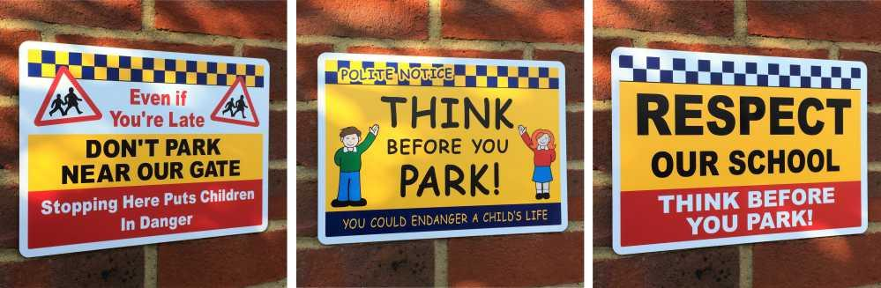
We need your help!
Tell your parents.
Poster competition – 27th February.
Notes:
We need your help to tell parents about the dangers of parking outside our school gates.
We are also going to hold a poster competition. We would like you to design a poster to tell visitors and parents why they shouldn’t park outside our school gates.
The winning poster will be displayed around our school and on the gates.
The winner will also receive a prize.
You can design a poster by yourself or with a friend, but we would like all entries in by Friday 27th February. You can give your posters to a member of the Safety Squad or to Mrs Watkins or Mrs Nicholls.

