Slide 1



Safety Squad
Ysgol Gynradd Goetre

Slide 2
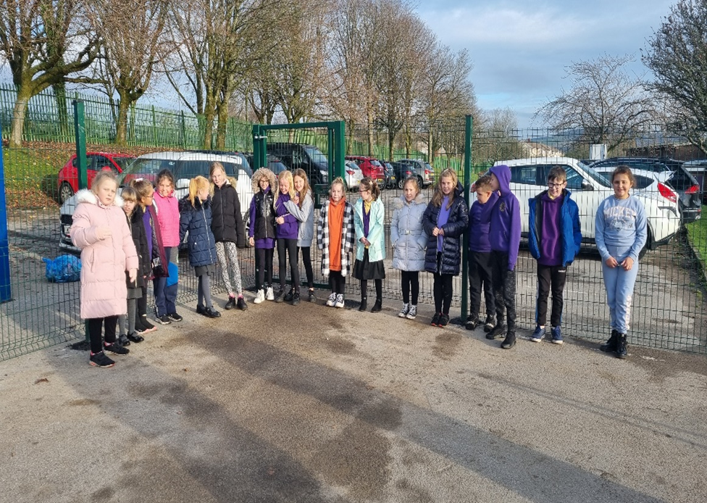
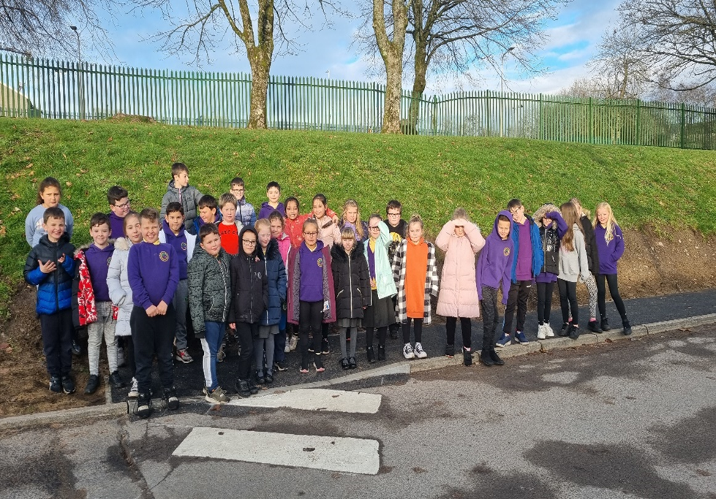
Safety Squad
We walked around the school with Stephen (our caretaker) to see the new zebra crossings, path and fences that have been put in to keep visitors, staff, our parents and ourselves safe in the school grounds.
Ysgol Gynradd Goetre

Slide 3
Safety Squad
We presented an assembly to the junior department about the dangers of parents and visitors parking outside our school gates.
We asked the children to design a poster which can be displayed around the school and on the gates. The winning poster will receive a prize.
Ysgol Gynradd Goetre

Slide 4
Safety Squad
Ysgol Gynradd Goetre

Slide 5
Safety Squad
Ysgol Gynradd Goetre

