Slide 1



First Committee Meetings
Our first meetings were held on Friday 14th October. The children met with their groups and their staff members and came up with ideas for how their group will work and what they are going to work on. They also talked about possible name changes for their groups. The children were set the challenge of designing a logo for their group which will be displayed on our ‘School Council’ display board and made into badges for the children to wear.
Children put themselves forward for specific roles within the committees and voting took place to decide who was elected into different roles.
Ysgol Gynradd Goetre

Slide 2
Community Engagement Officer (Blair Cannon) Meeting
Ysgol Gynradd Goetre

Slide 3
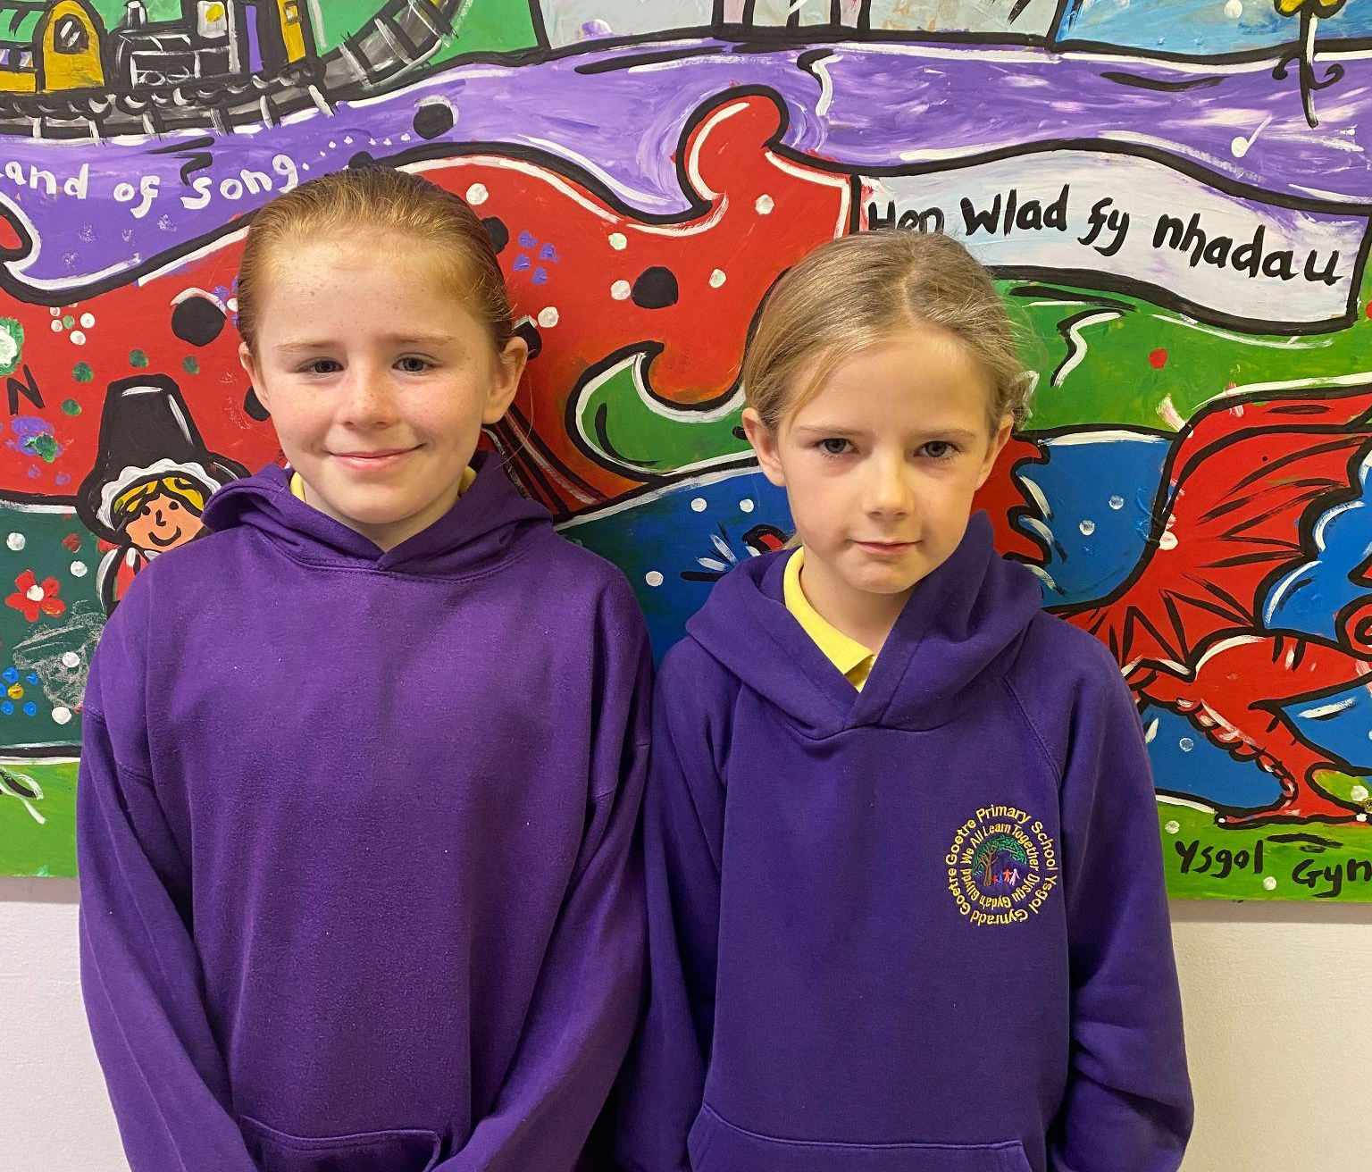
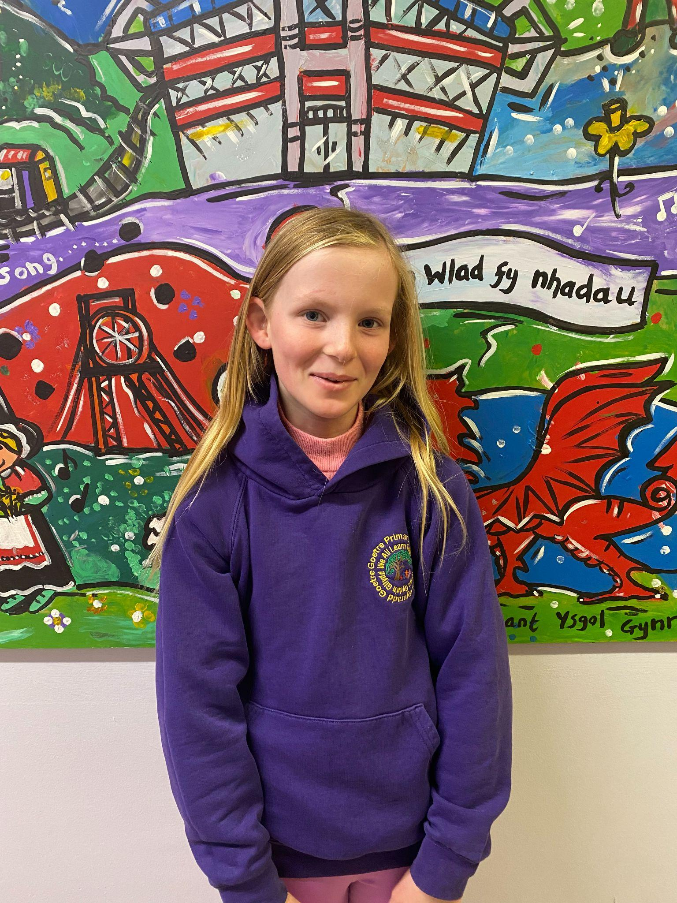
First School Council Meeting
The children met to discuss the roles of the School Council and what responsibilities were needed to be undertaken to be successful. The children were spoken to about the structure of a committee or council and some of positions. They were spoken to about the roles of chairperson, vice chairperson and secretary.
The members of the school council put themselves forward for these positions on the school council and then other members voted for each of the positions. Two children were opted onto the council for each of the positions.
Ysgol Gynradd Goetre

Slide 4
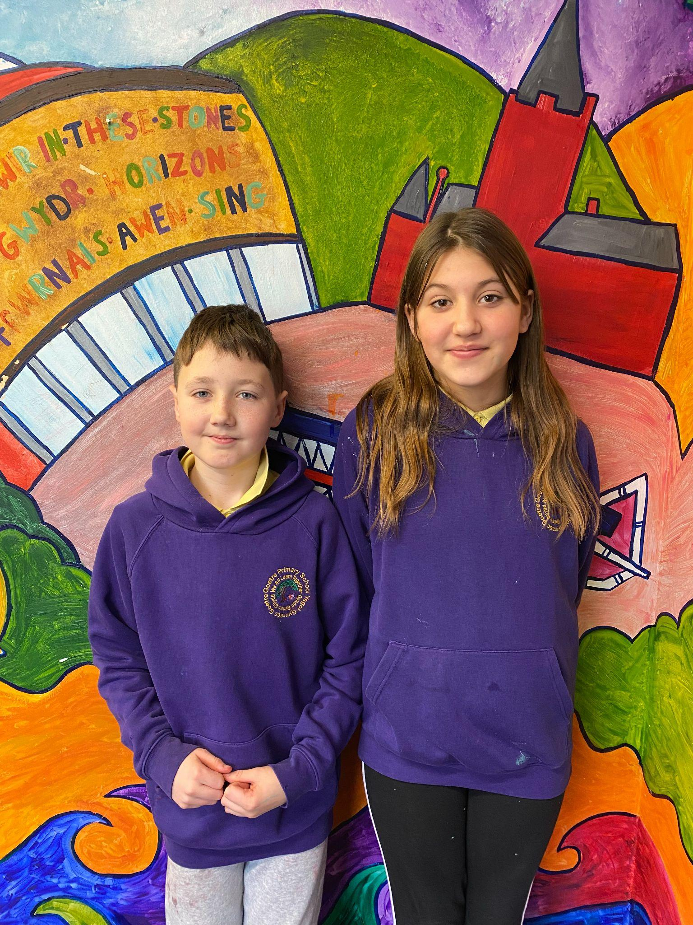
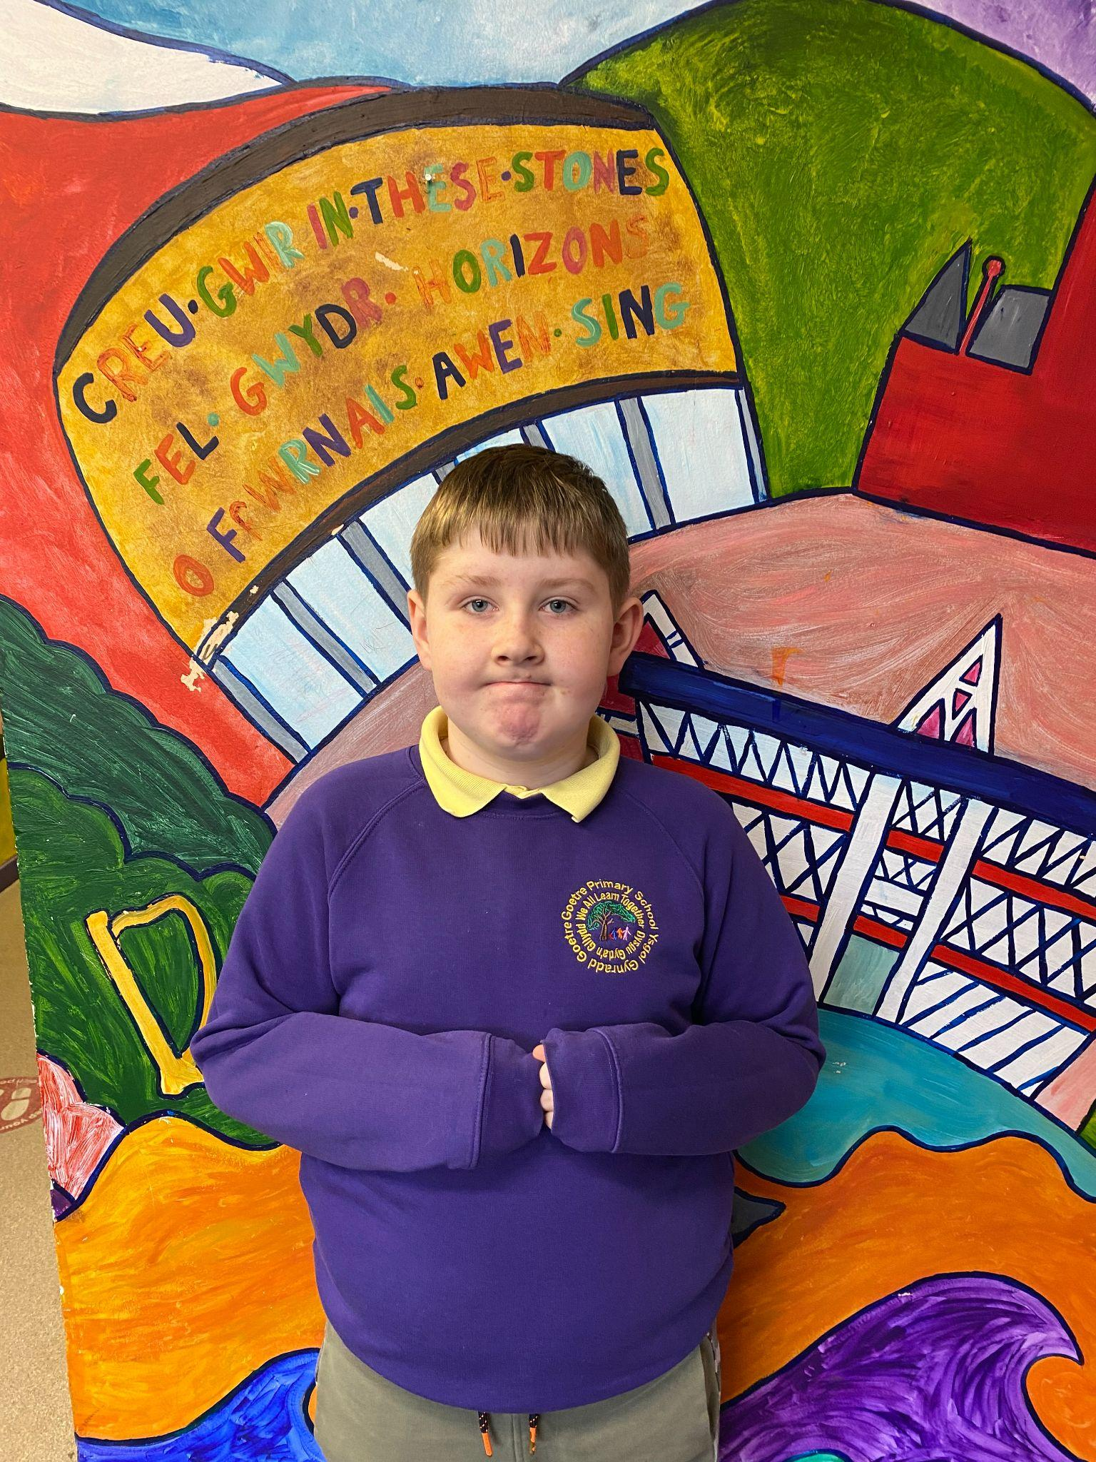
First School Council Meeting
Congratulations to the children who were elected for the different positions in the School Council
Co Chairperson
Macey Hill and Kourtney Clegg
Co Vice-Chairperson
Alfie Lindsay and Liliarna Lakatos
Co Secretary
Brayden Williams and Lilly May Plaine
Ysgol Gynradd Goetre

Slide 5
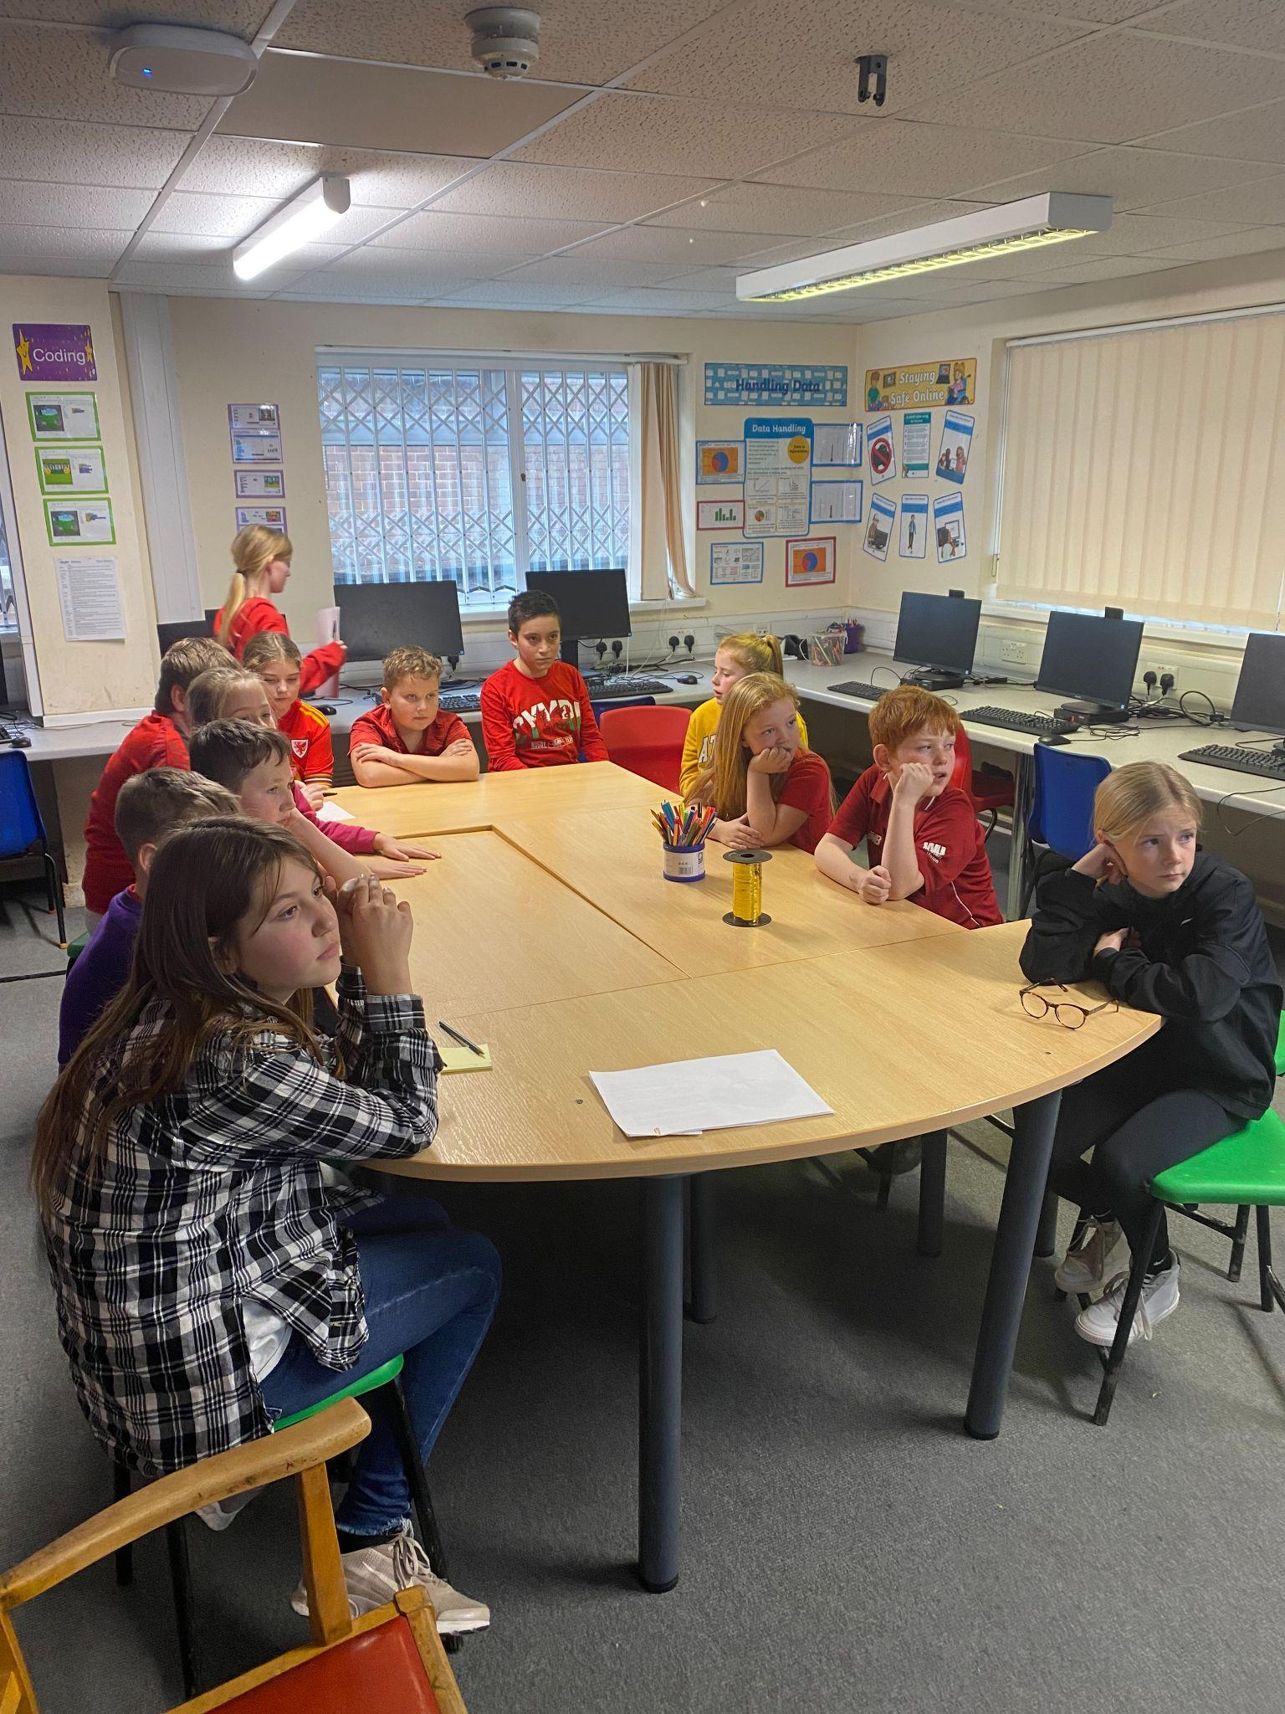
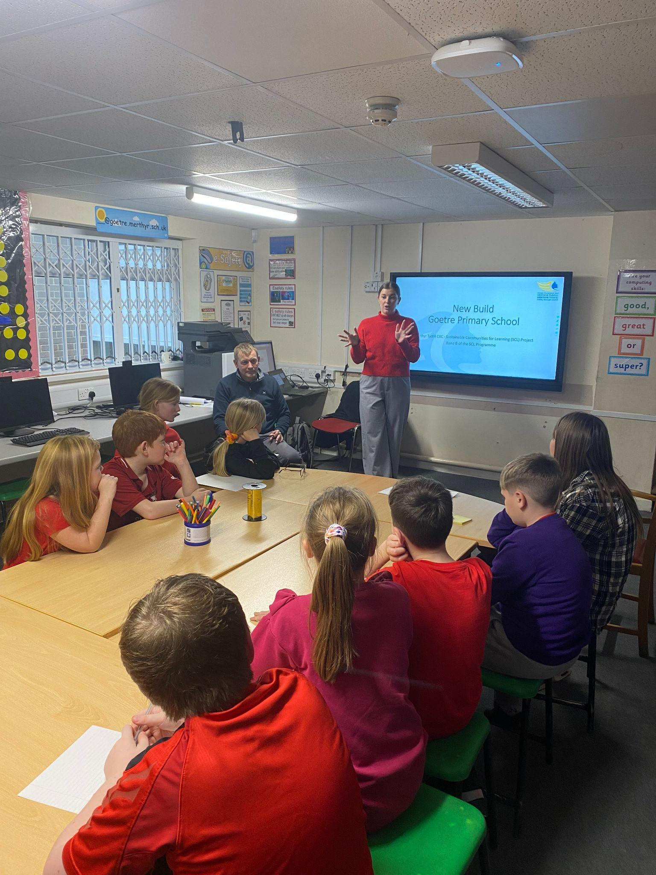
New Build (2025) Meeting
The School Council met with members of staff from LEA on Friday November 25th to discuss the plans for the Goetre new build in 2025.
The children discussed some of the positive points and some negative points in Goetre at the moment and discussed ways in which they felt could make the new build a success. The children discussed 3 questions on the day and were asked to take these questions back to their respective school committees.
Ysgol Gynradd Goetre

