Slide 1
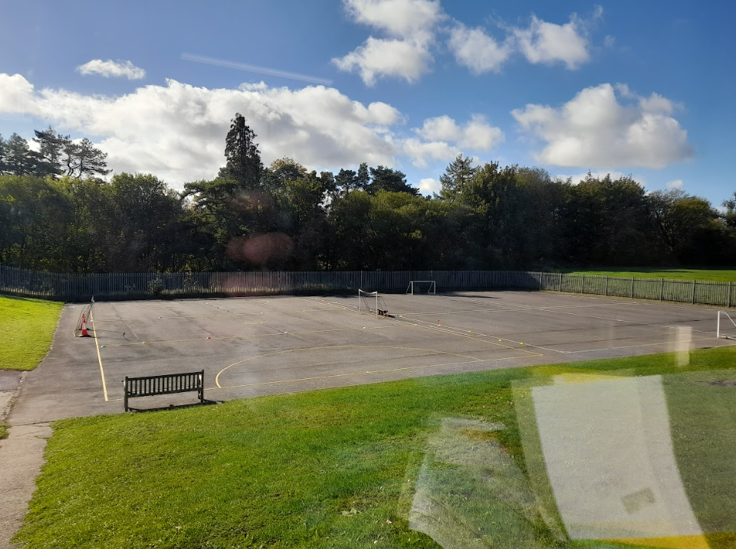

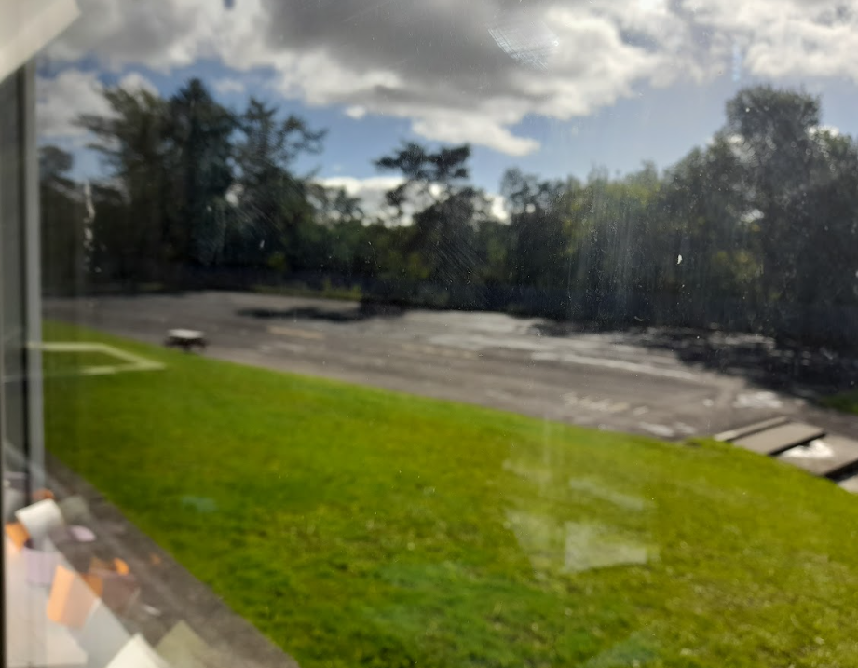
Playground Development at Goetre Primary School
PLEASE VISIT OUR GOOGLE CLASSROOM TO VIEW TASKS WE HAVE COMPLETED

Slide 2
Group register
Ethan John Eva Rees Jayden-Leigh Corcoran
Jacob Rubbery Anniah Astley Milena Bielska
Lyla John Jaylan Best Shyla Cavender
Corbie Davies Jacob Brown Morgan Pembridge
Tamia- Leigh Evans Skyler Lewis Arayah Yanez
Leila Evans Brayden Lee O’Brian Olivia Mazoni
Levi Oscar Moore Natalia Thomas Eaton Phillips

Slide 3
Group register
Kanye Hitchins
Harvey Davies
Liam Davies
Drake- Rees Williams
Ioan Howells
Keaton Jones
Chaze Ogunkoya
Lotti Thomas
Rico Griffiths
Troy Wall

Slide 4
Play Leaders - Mr. Hughes & Mr. Thomas
Possible name of our group -
Guardians of the Equipment Goetre Play Leaders Play Helpers Play Pals
Final name choice - The Guardians of Play
Chairperson - Lottie Thomas Year 6
Vice Chairperson - Kanye Year 5
Secretary - Troy Wall Year 6
Minute taker - Liam Year 6

Slide 5
Sessions completed
Week 1 - Meeting with Julie from Soverign Play.
During this meeting we met Julie for the first time, showed her our playground and shared some ideas on what we would like on our playground. We also did some design work which is in our google classroom.
We now need to email some of our designs to Julie.
Week 2 - Look up designs / Pick some play equipment with staff from brochure (WB. 24/10/22).
The pupils designed a logo. The Chair and vice chair will look through and pick the best logo for Guardian of Play Equipment. We took time to look through the brochure in groups and pick a range of items to send over to Julie.

Slide 6
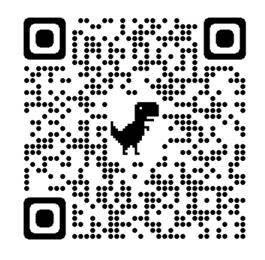
Week 5 - Visit Twynyrodyn Primary School Playground with Mr. Hughes & Mr. Beech. (Wk. 14.11.22)
Week 21.11.22 - Chairperson & additional play leader met up to design playgrounds from different catalogue to compare.
Week 28.11.22 - (2.12.22)
Today we the chair, vice chair and secretary met with another play company. They were really impressed with playground designs! We spoke to them about what we would like to include on our playground and explained why. We are now awaiting designs to get back to us. (Still no information from Julie - Sovereign Play)
Last week of 2022 term - 22.12.22 -
To find out what we got up to please follow our minutes link - https://docs.google.com/document/d/1QvVSoomXgQ_dBE0I-1TaKq-ftz9ZTJ9o/edit OR scan our minutes QR

Slide 8
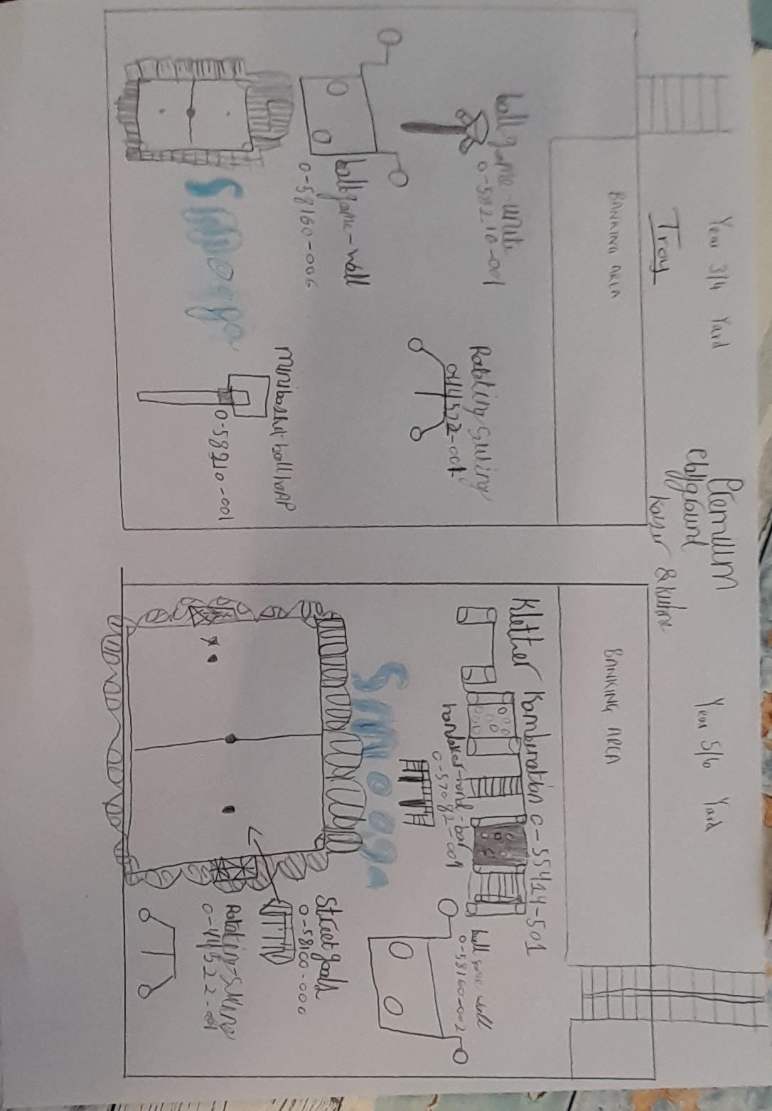
Playground designs from play leaders
21.11.22
Lottie picked another pupil to draw up final designs after looking at 3 play catalogues.
Troy Wall - Year 6

Slide 9
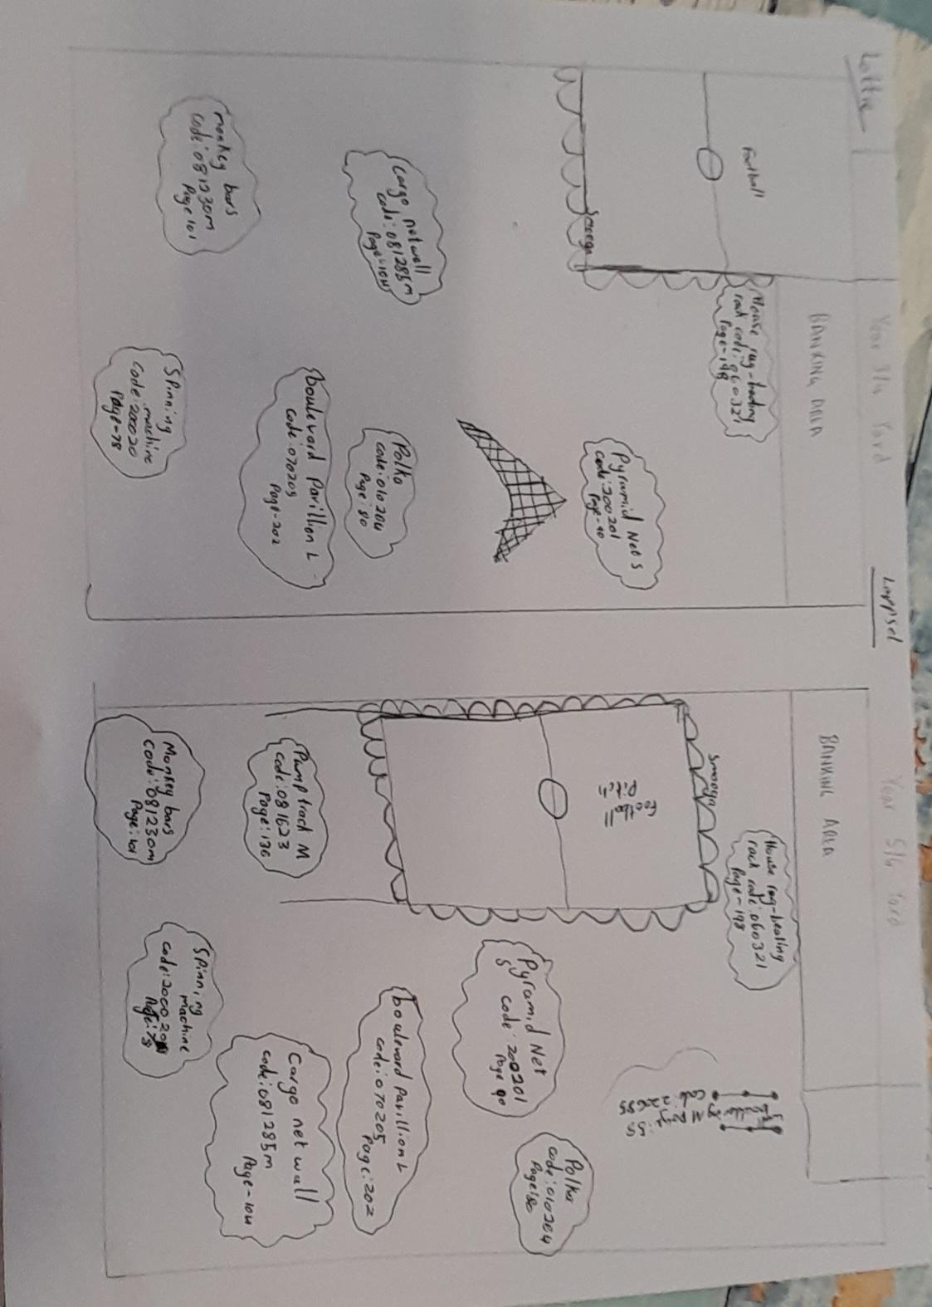
Lottie Thomas - Chairperson - Year 6

Slide 10
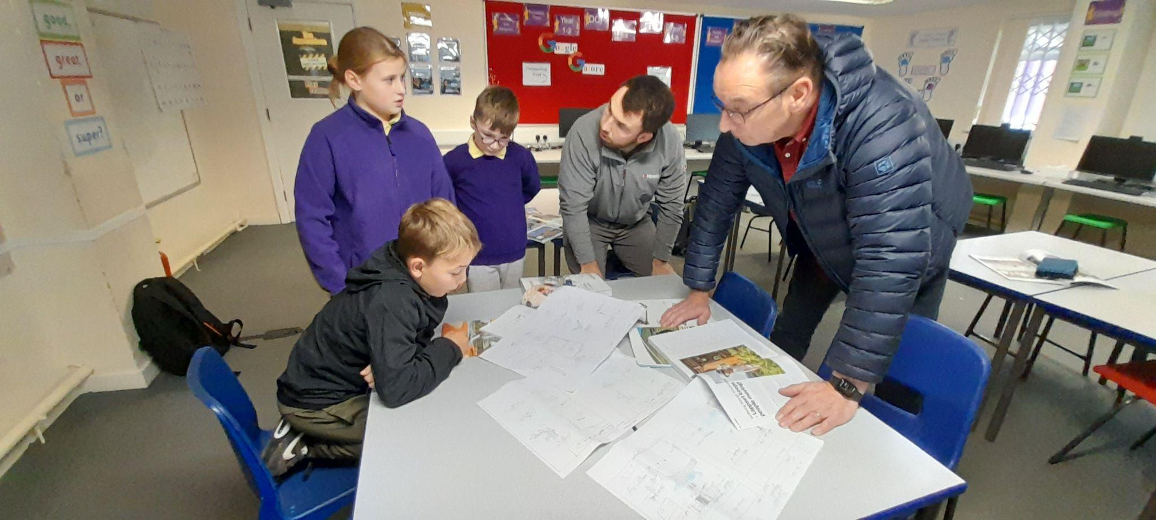
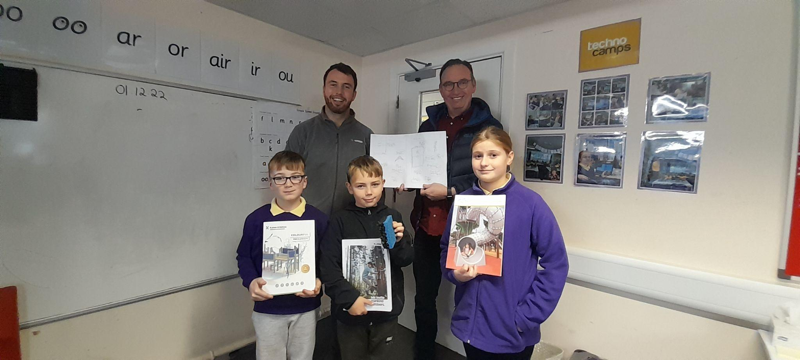
2.12.22 - Meeting with playground company - Design ideas and feedback.
Sss
Today we met with Gareth and Dave from an additional play company. We took a look over our design ideas, looked at safe surfaces and put a date in the diary for next week to look over some design ideas from the professionals.

Slide 11
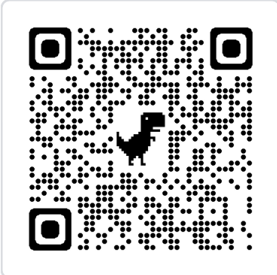
21.12.22 - Updating whole group and final logo design
Minutes from meeting - Liam and Troy
Mr. Hughes and committee on the group fed back what has been happening over the past few weeks (Meetings with play organisations, designing, quotes).
Mr. Beech has been giving 3 prices for play equipment.
Julie from Sovereign play did not respond back
We are now looking through a range of designs and creating digital logos.
DESIGN TIME - Mr. Hughes has given us time this session to create digital logos.
Peer assessment on logos - Time to improve and finalise
Mr. Beech will now pick the winner logo to represent our school council.
IF YOU WOULD LIKE TO TAKE A LOOK AT SOME OF OUR DIGITAL LOGO DESIGNS - PLEASE SCAN THE BARCODE!
ANY FEEDBACK WOULD BE APPRECIATED!

Slide 12
The first things we will do in the new school year are….
Design a school logo for our Guardians of Play Equipment team.
Await Julie’s design from playground design team.
Visit Twynyrodyn Primary School to take a look at their school playground.

Slide 13
Pupils suggestions -
Mini golf
Scooter track
Climbing / Team building wall
Drawing area

Slide 14
Year 5 / 6 yard

Slide 15
Banking area
What would you like to see on the yard?
____________________
____________________
____________________
____________________

Slide 16
Year 3/4 yard
Swings
Garden area
Sovereign play equipment

Slide 17
Banking area
What would you like to see on the yard?
___________________
___________________
___________________
___________________

Slide 18



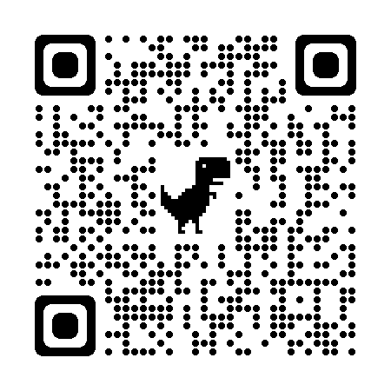
The Guardians of Play
Coming soon!
Digital logo to be stuck here!
To view any tasks we have completed. Please visit our google classroom.
To follow our journey of improving play at Goetre Primary School
PLEASE
SCAN OUR BARCODE!

