Slide 1

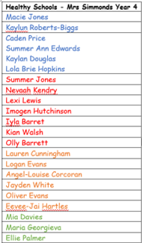


Healthy Schools
Group Members - Children from years 3-6 chose which group they wanted to be a part of and gave a valid reason why they wanted to join this group. Our group is made up of :-
Ysgol Gynradd Goetre

Slide 2
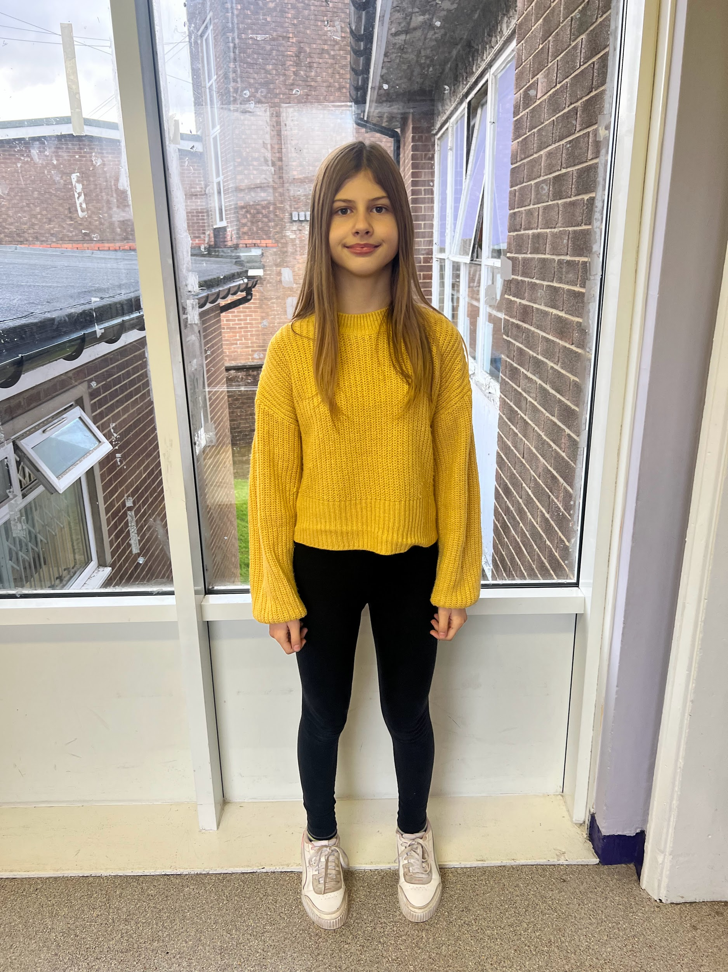
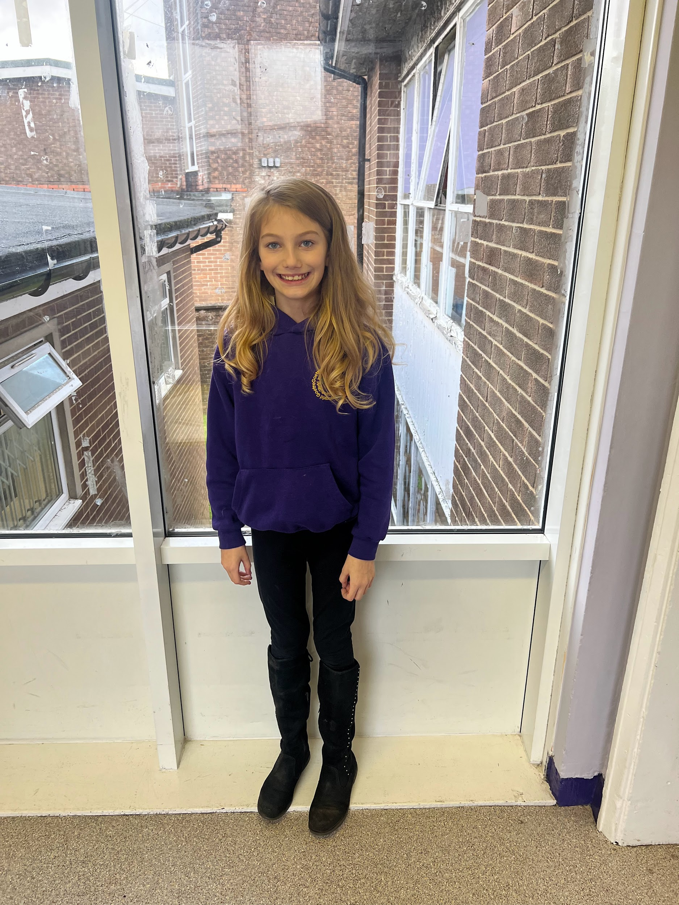
Healthy Schools
First meeting - Deciding roles.
During our first meeting, we decided on the roles of the group members and what we would like our group to be called. We decided to stay with Healthy Schools (for now) and who our Chair, Vice Chair and minute taker would be.
Chair - Maria
Vice Chair - Ellie
Minute taker - Evie - Jay
Ysgol Gynradd Goetre

Slide 3
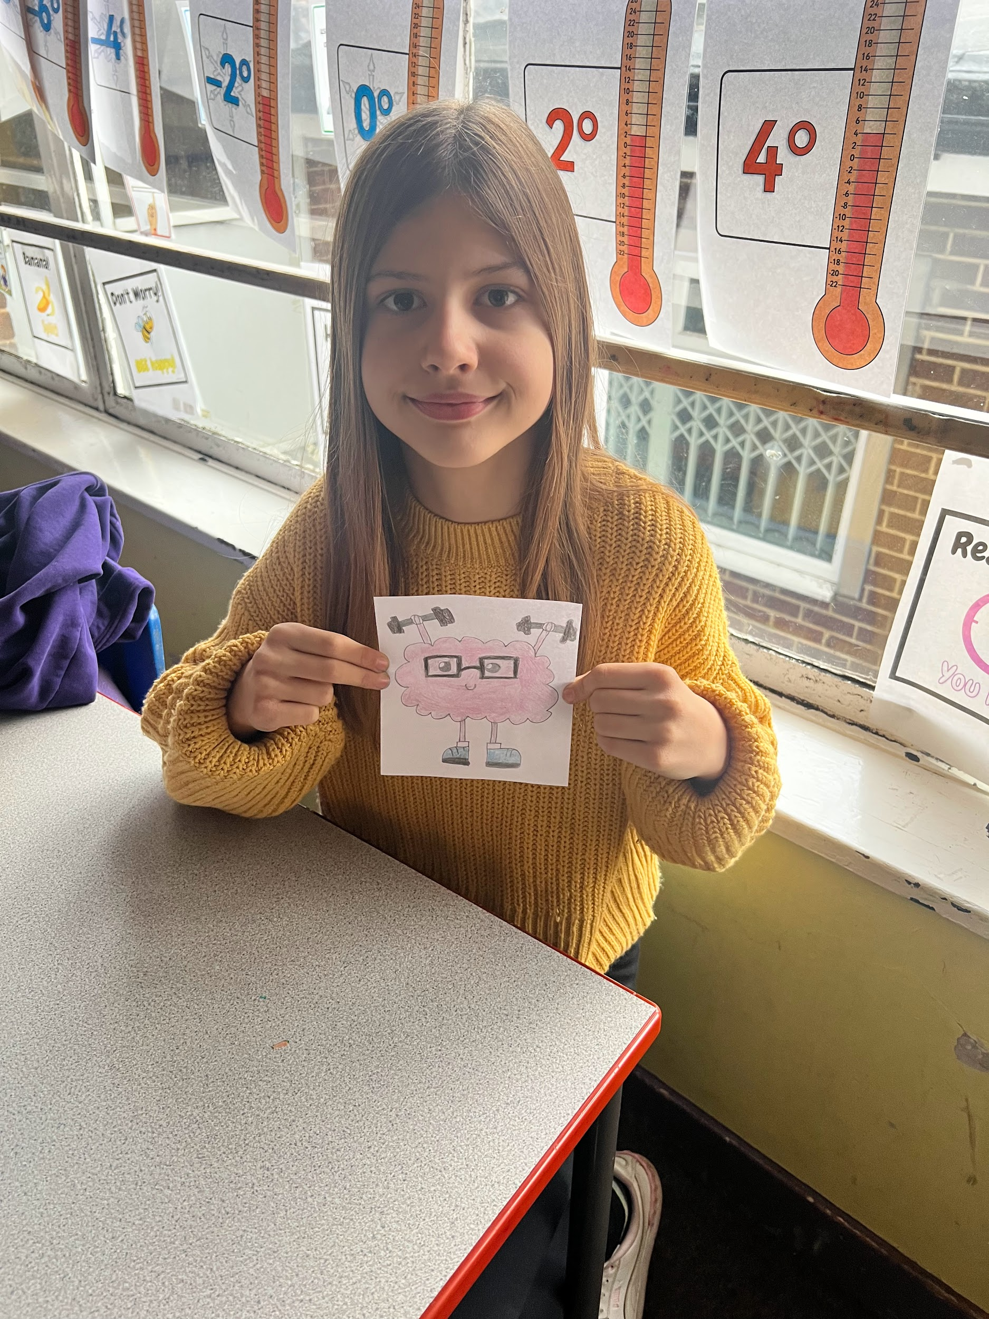
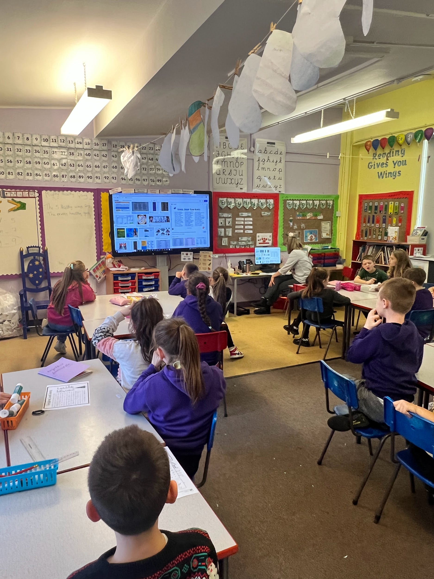
Healthy Schools
Second meeting - LOGO
The children decided that healthy schools was not just about having a healthy body, but a healthy mind too. The children researched other school logos, chose ones they liked and used these for inspiration to design our own. The children came up with a number of logos, voted and the winning logo was decided.
Ysgol Gynradd Goetre

Slide 4
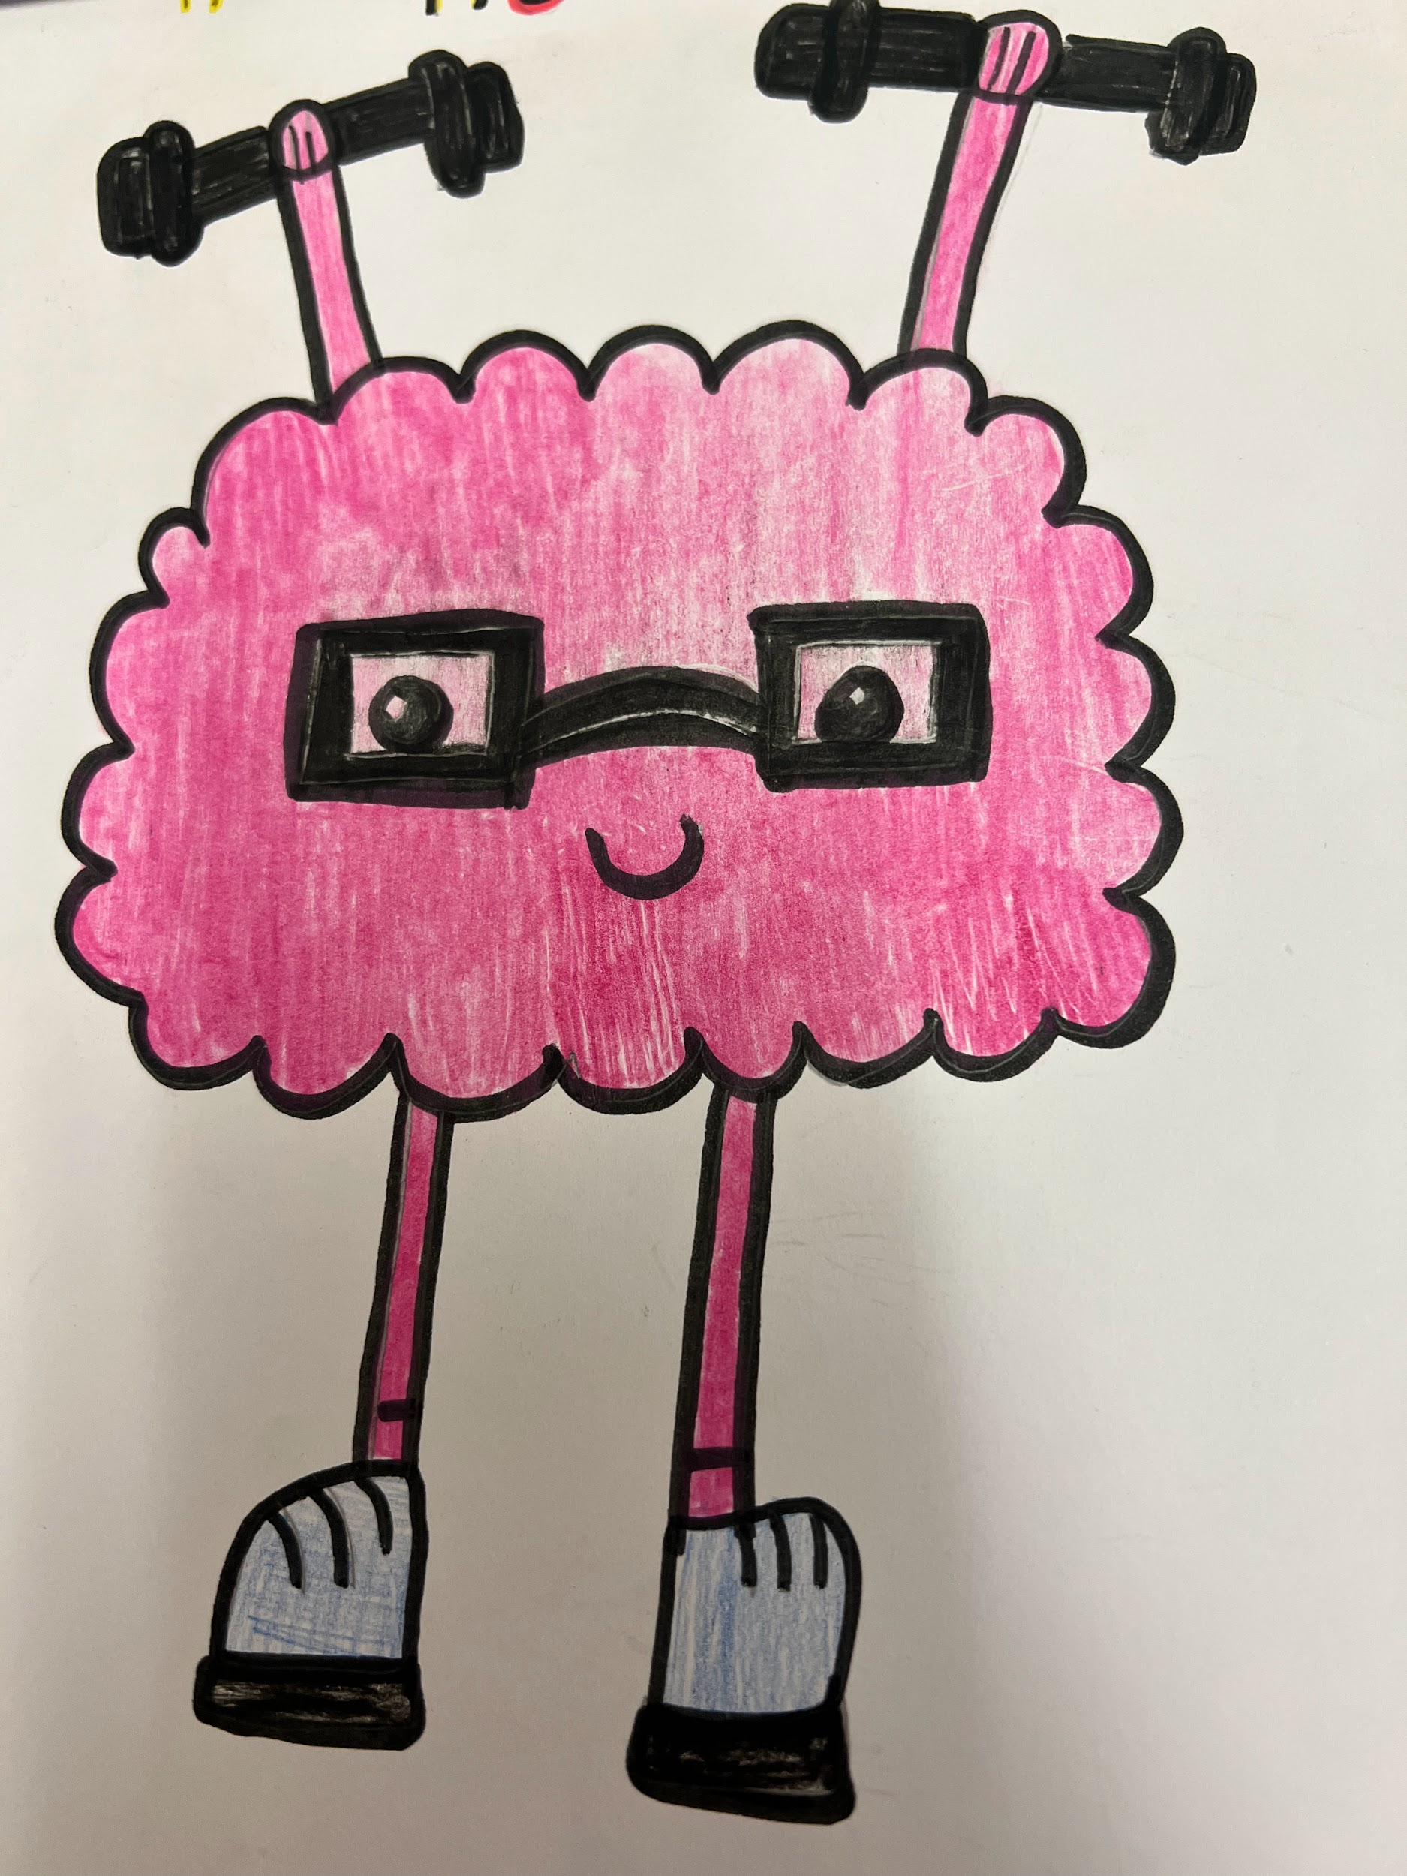
Healthy Schools
Our group logo is
Ysgol Gynradd Goetre

Slide 5
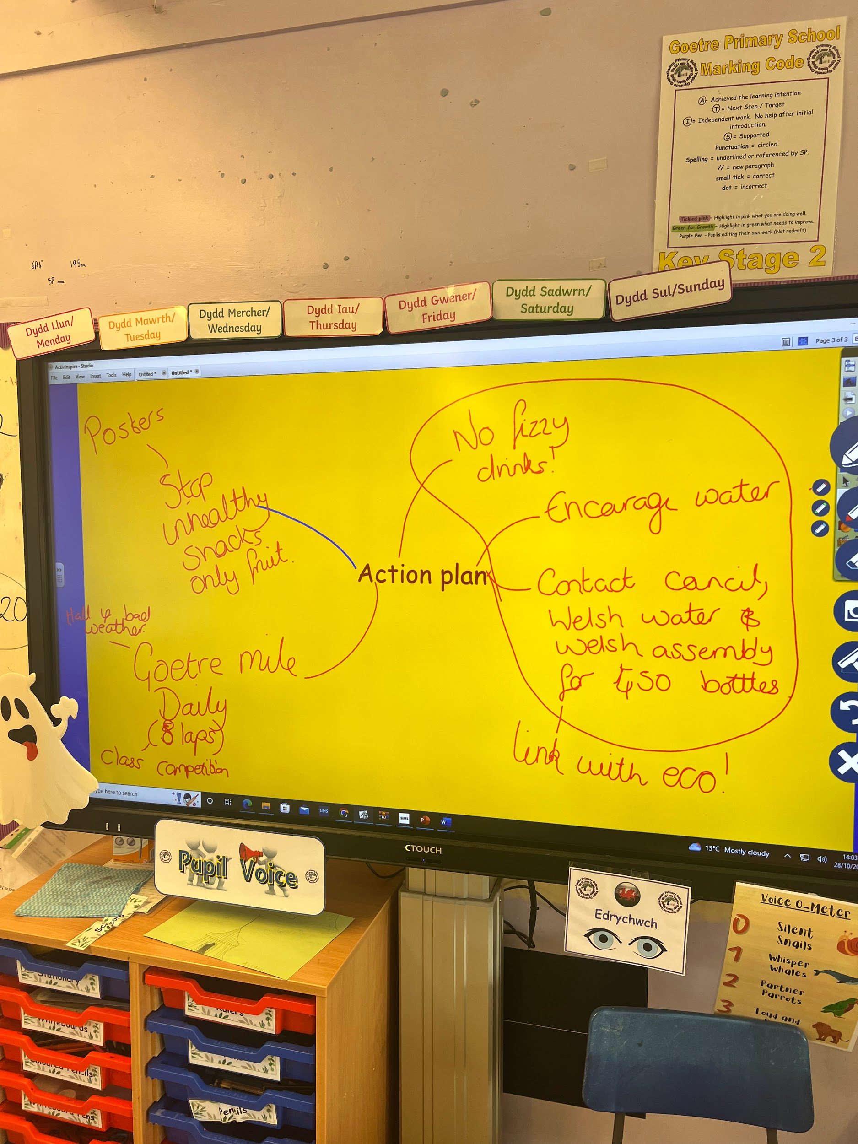
Healthy Schools
Week 3 : Action
After deciding on our group name, logo and roles of members, the children decided it was time for action. We had a whole class discussion about how we could make the school healthier, and one of the biggest issues was drinks. After talking to the eco committee, we decided that children needed to have a reusable bottle in school in order to combat the issue of single use bottles and unhealthy drinks. The children researched how we could supply children with a bottle and decided to contact Welsh Water and The Welsh Assembly Government to see if they could help.
Ysgol Gynradd Goetre

Slide 6
Healthy Schools
Week 4 : Rebranding
After looking at other logos and group names, the children decided on a rebrand. The children brainstormed ideas of a more catchy name for the group. They also decided to create a hashtag #.
Ysgol Gynradd Goetre

Slide 7
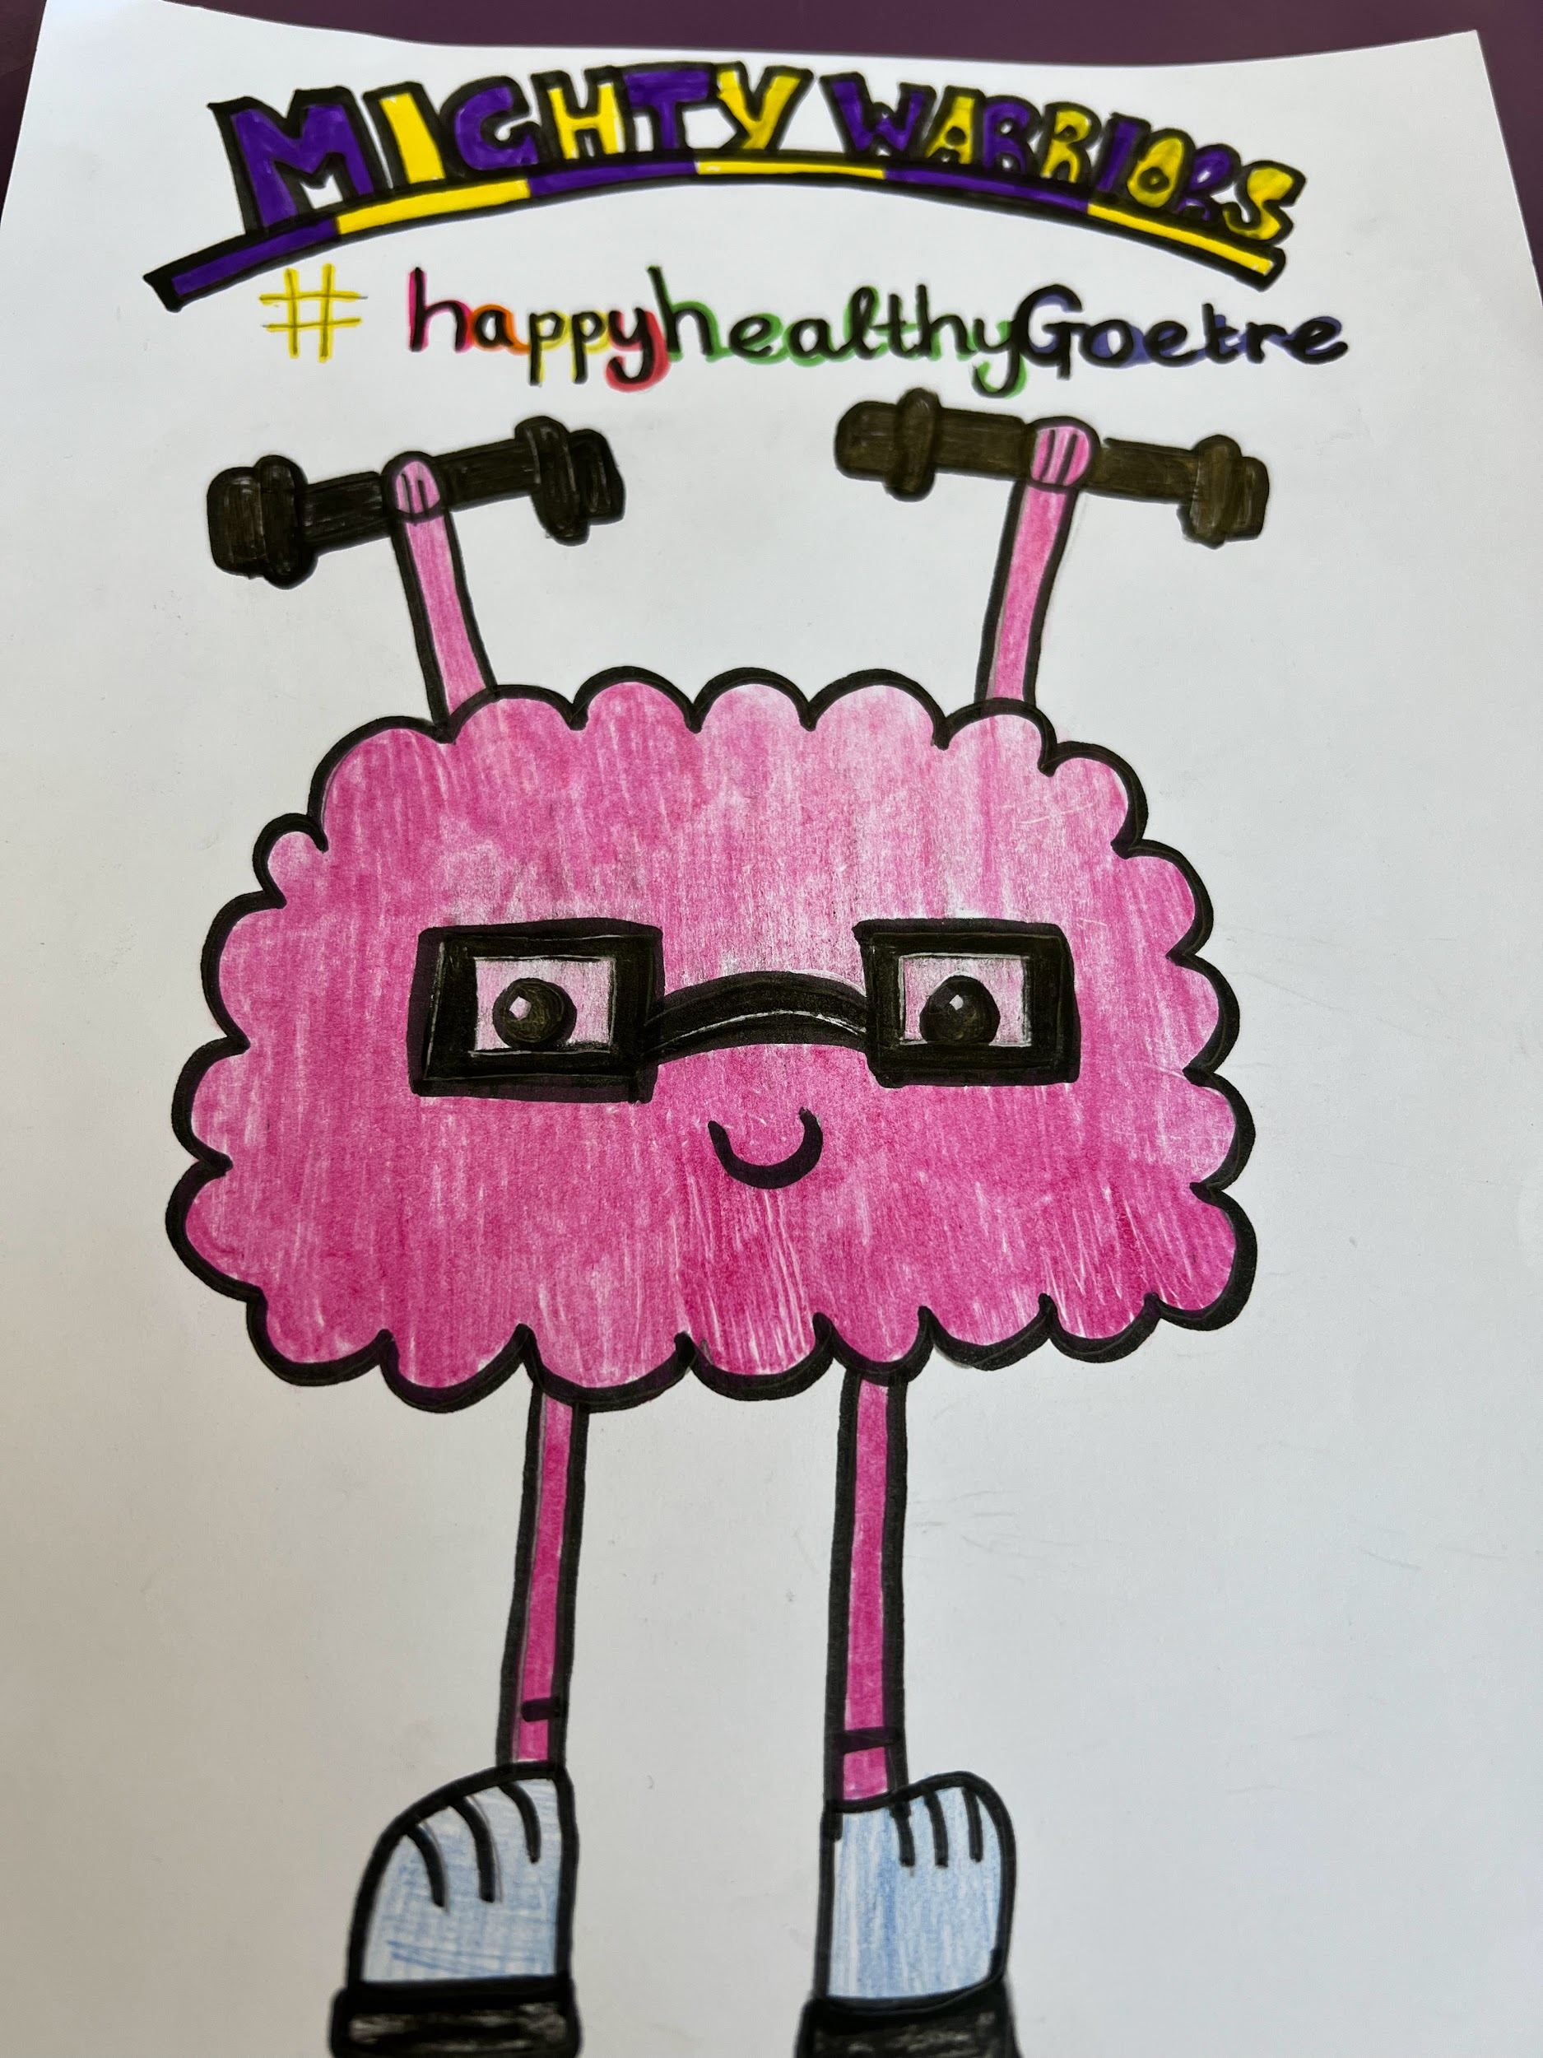
Healthy Schools
Our new Name and Logo :-
Mighty Warriors
#happyhealthyGoetre
Ysgol Gynradd Goetre

