Slide 1
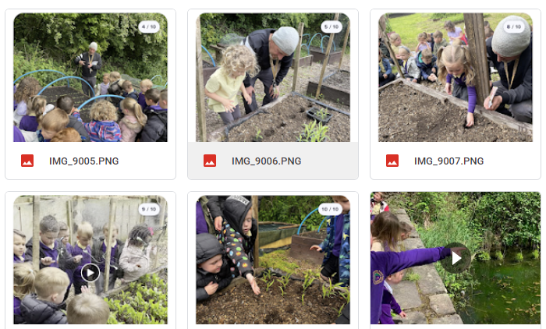
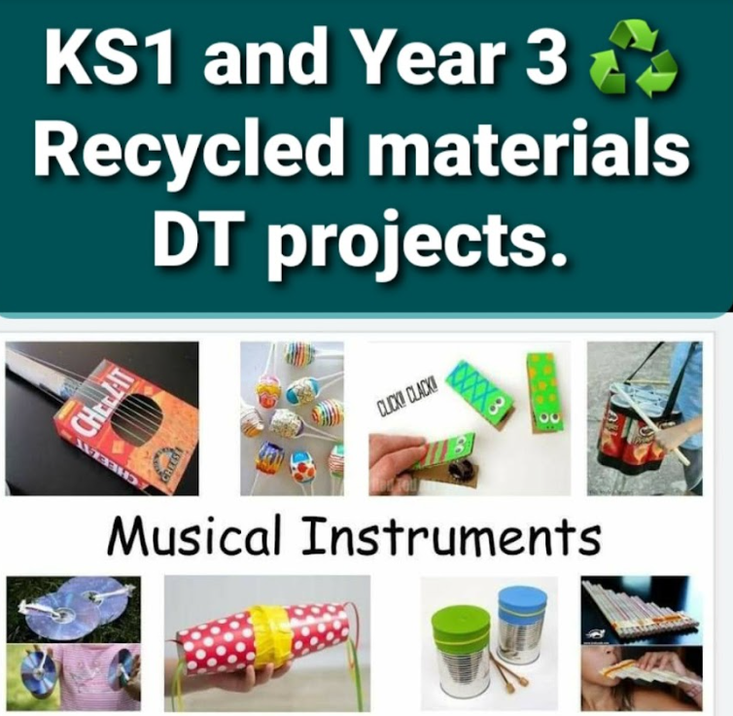

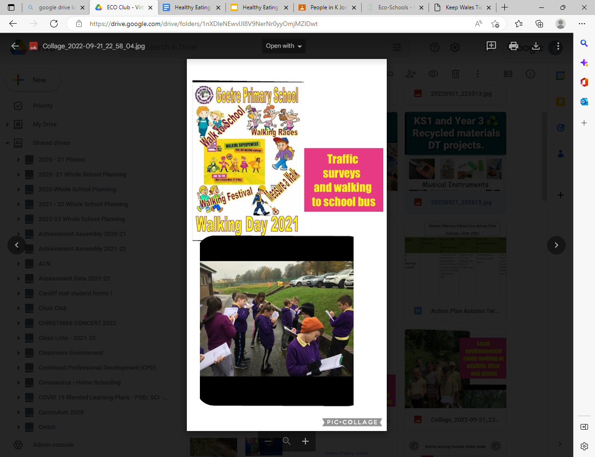
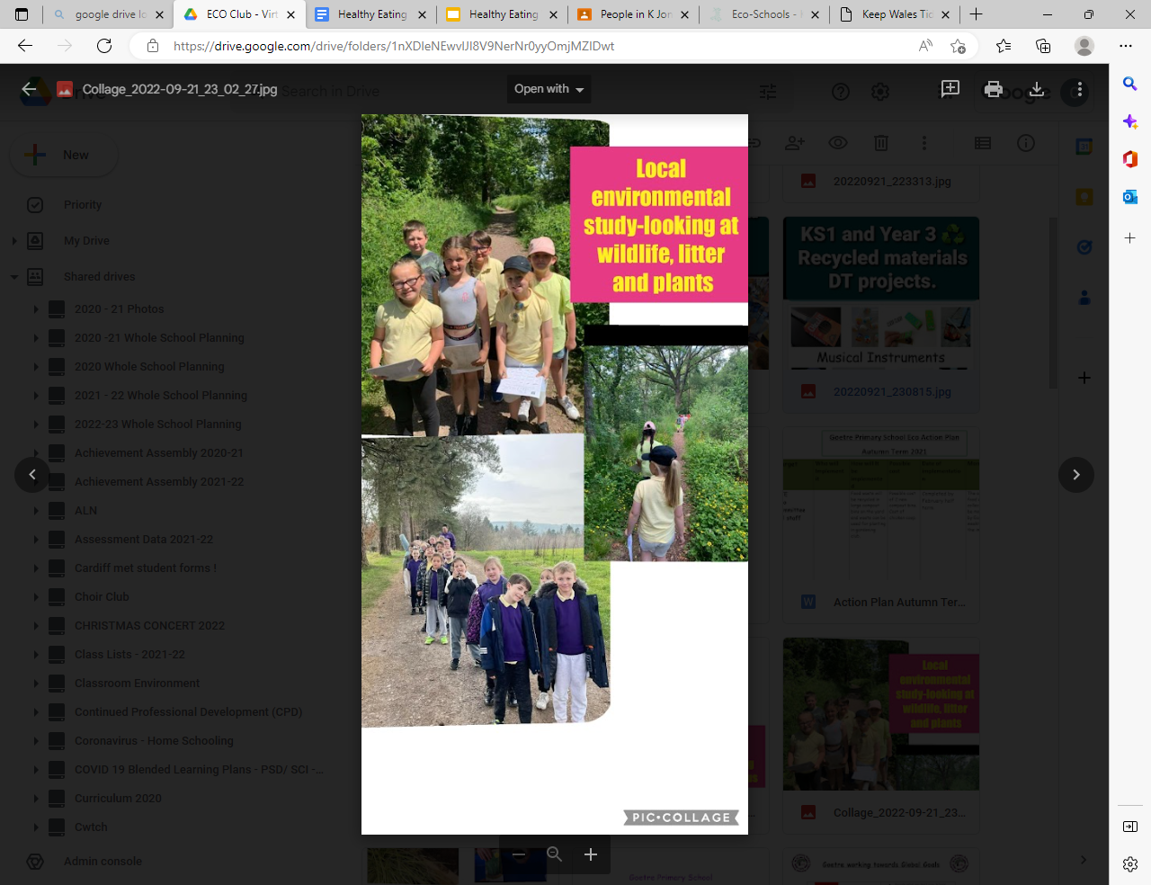
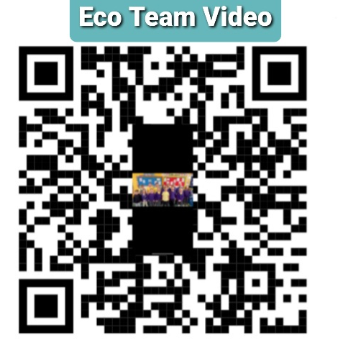
Eco At Goetre

Slide 2
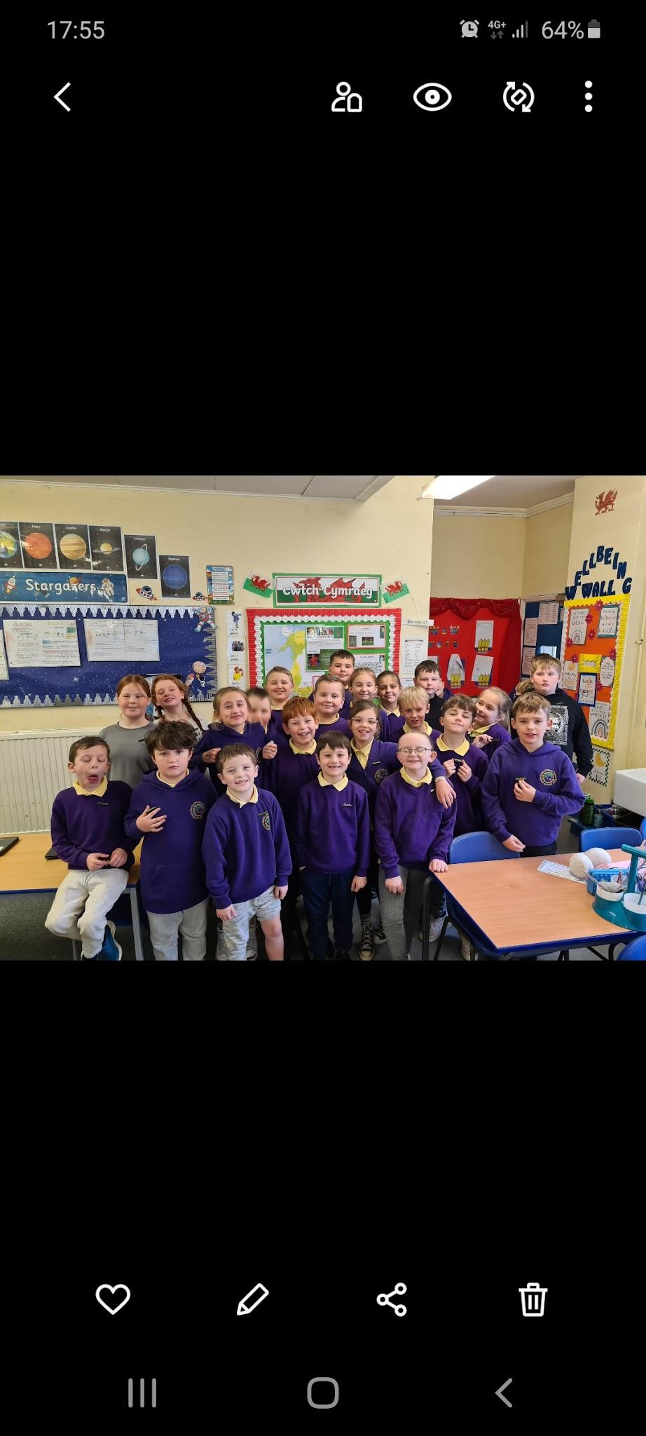
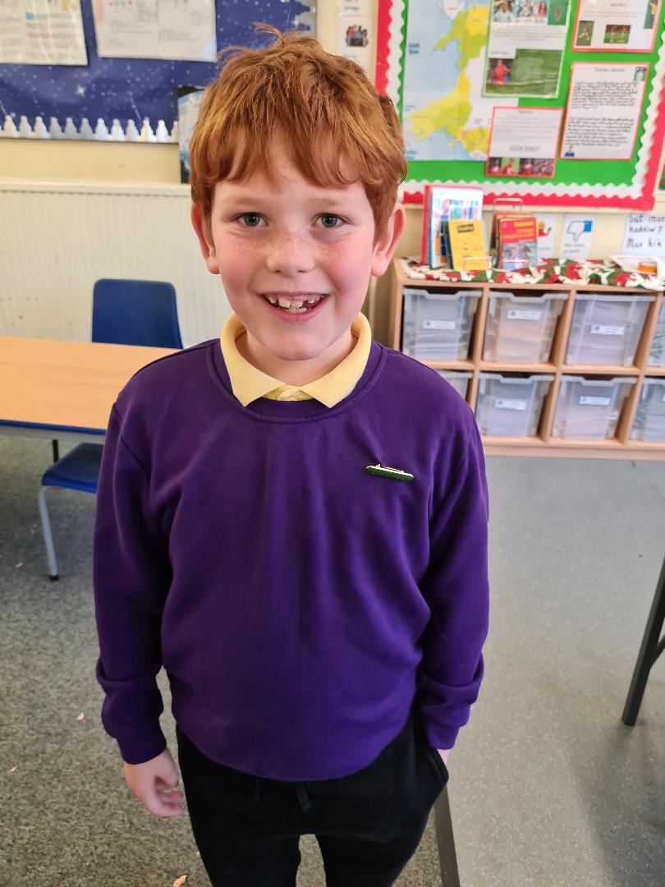
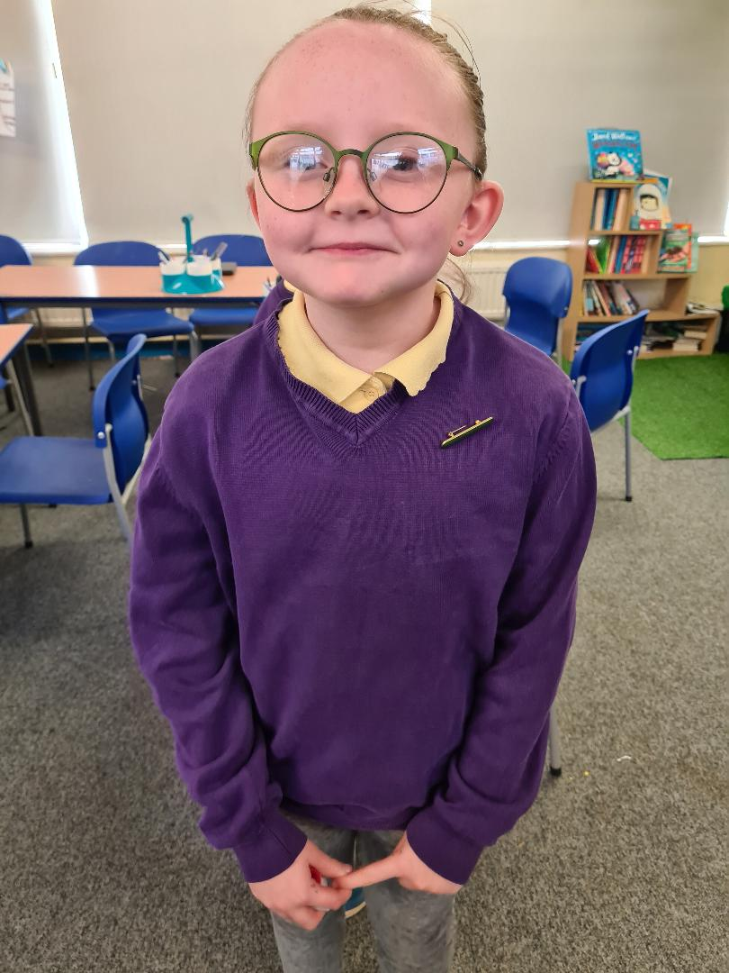
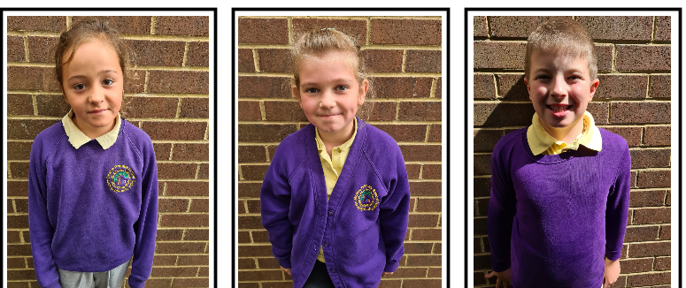
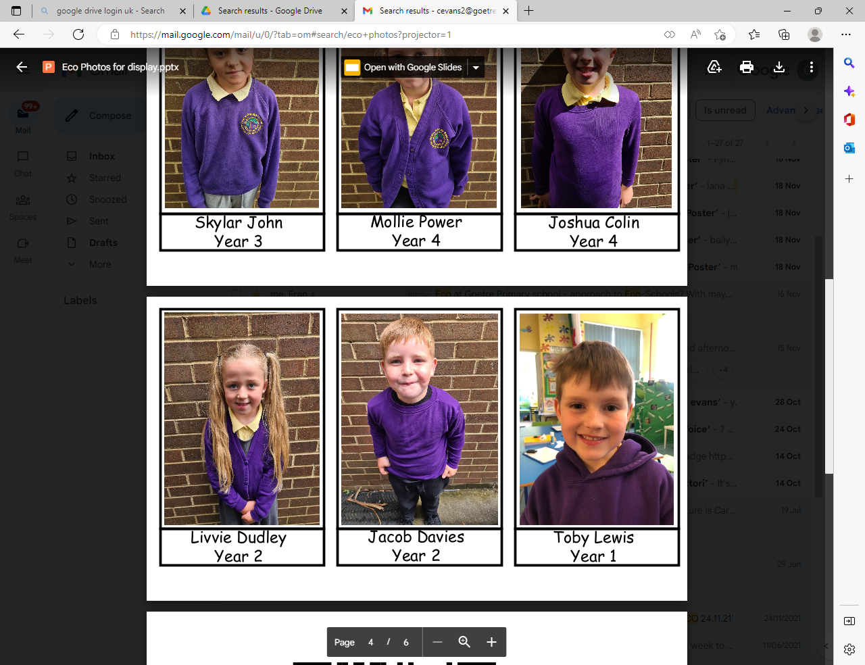
Meet Our Team:
Chair
Vice Chair

Slide 3
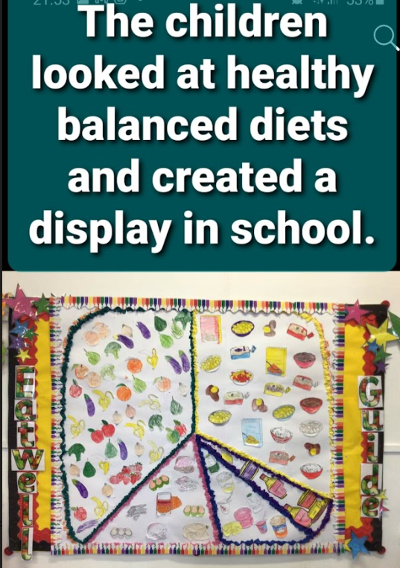
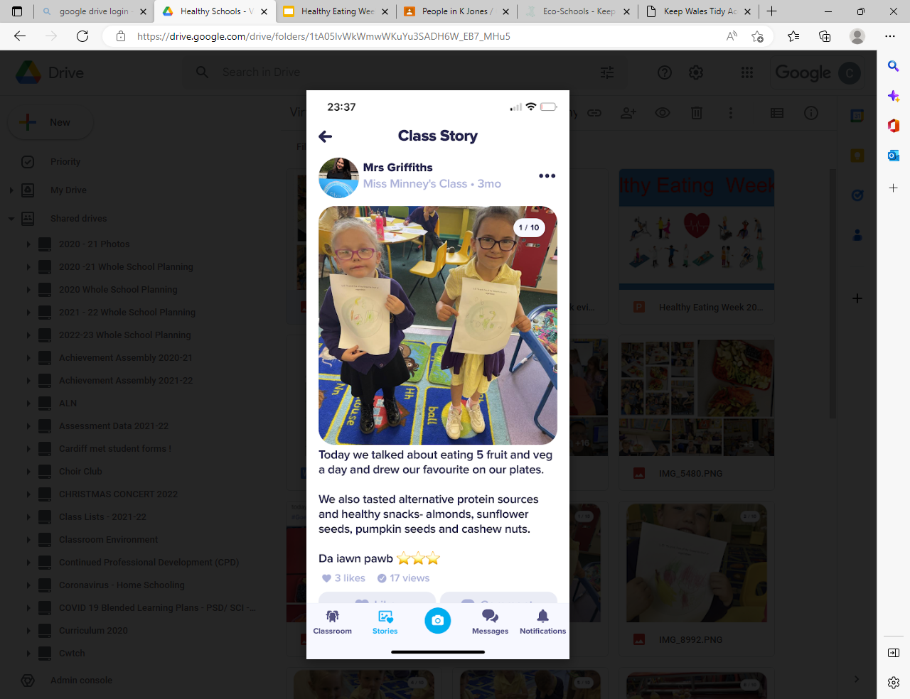
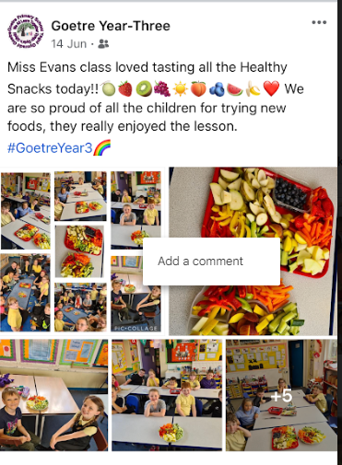
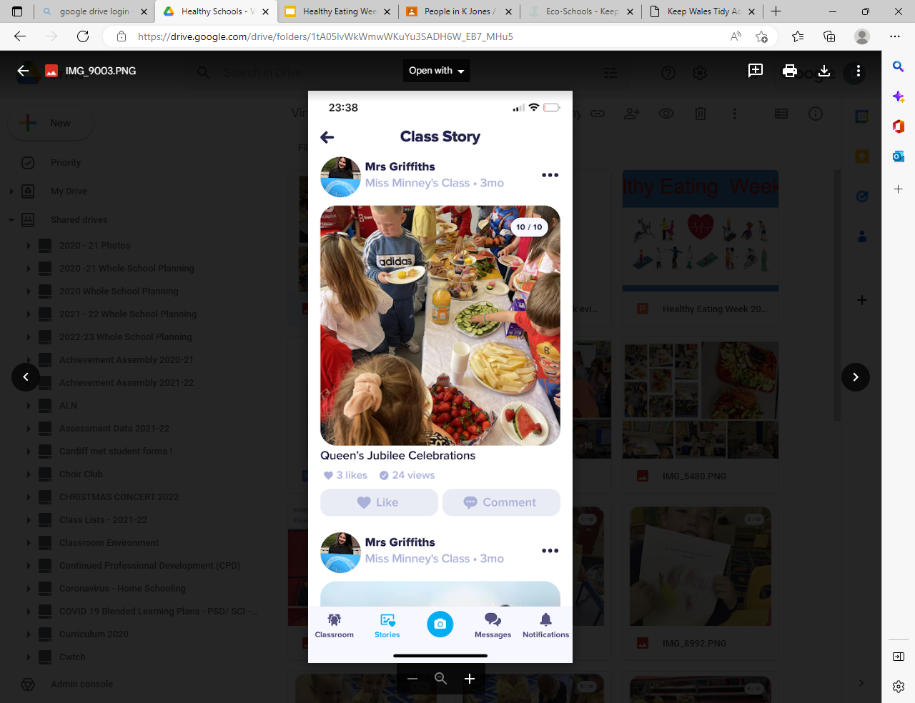
We aim to be Healthy Confident Contributors at our School and have completed lots of eco tasks…here’s a little snapshot of some of the things we have been up to here at Goetre…
We planned and delivered a whole School Health and Well-being Fortnight! We have also set up a healthy eating after school club.

Slide 4
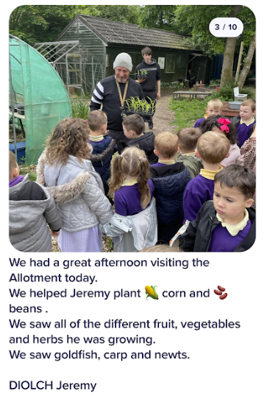
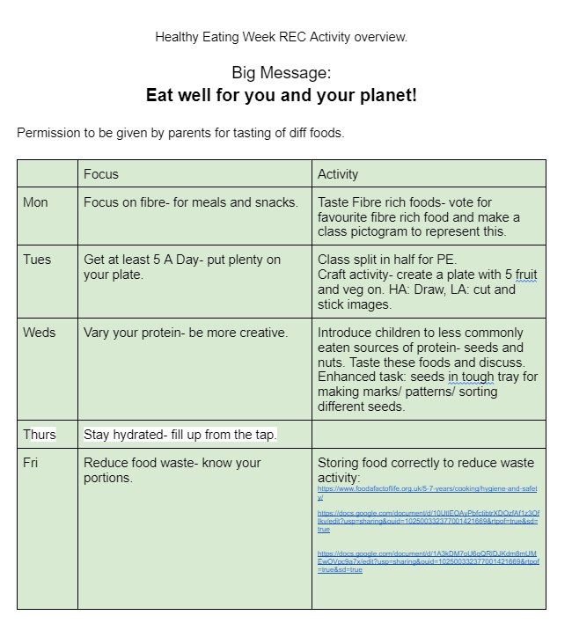
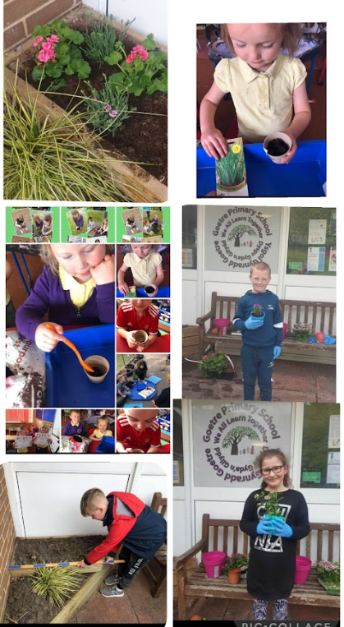
We have been learning about healthy diets and have also been developing our school grounds and have been planting and growing vegetables on our new flower beds and raised planters.

Slide 5
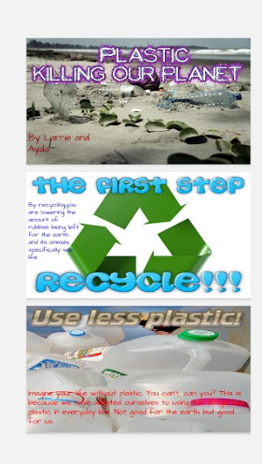
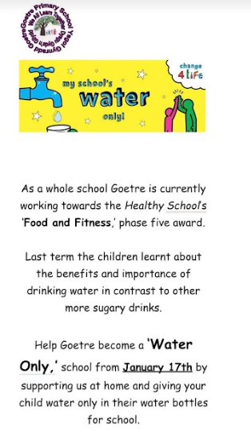
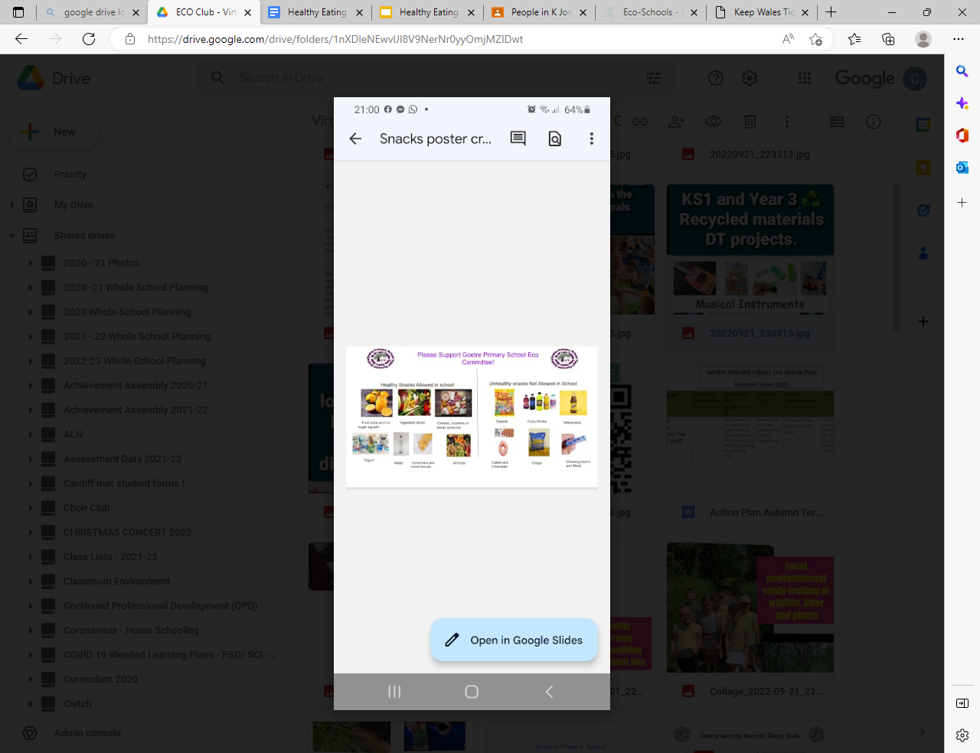
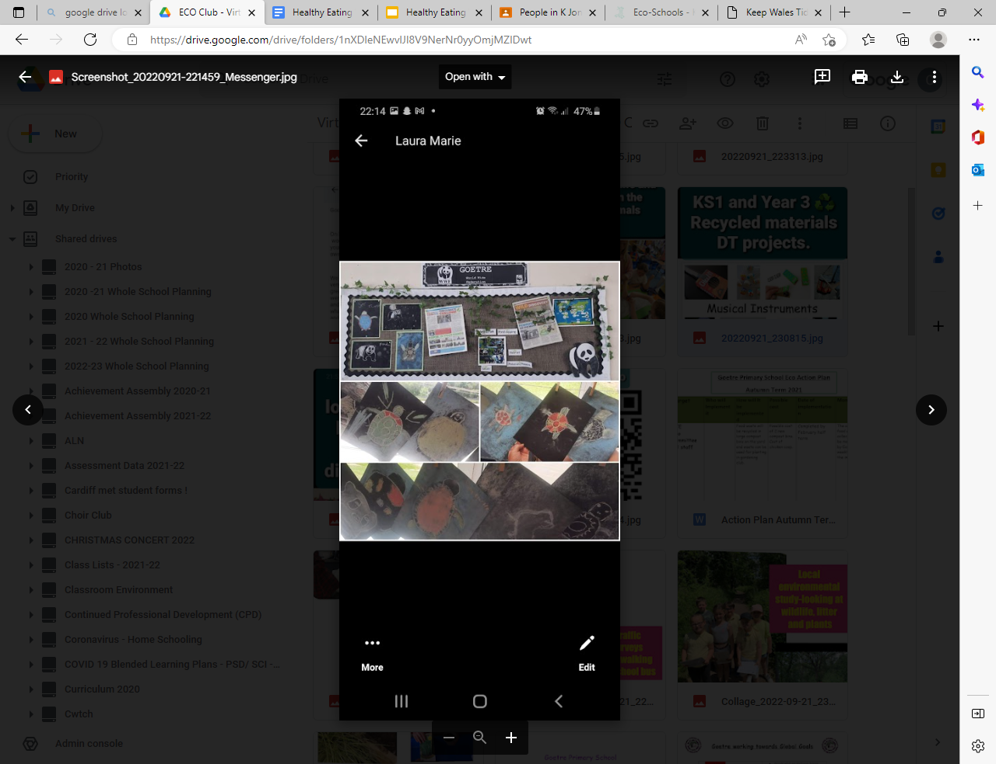
We have been liaising with parents, stakeholders and the wider community to educate on our aims as a school.

Slide 6
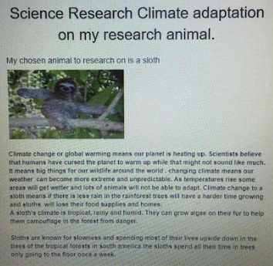
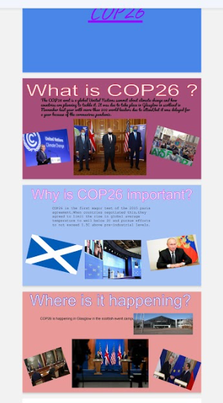
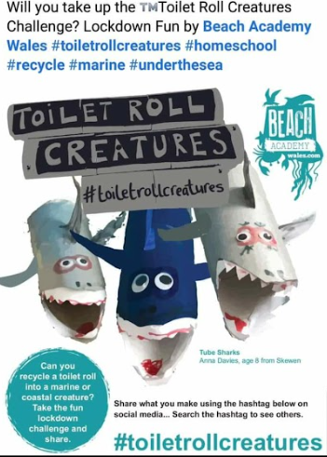
We are Ethically Informed Citizens
Through our Curriculum mapping we ensure all pupils are given opportunities to learn about our local, national and Global goals!
Overarching eco themes are evident in each year group planned for through the thematic units. Current coverage includes studying Fair Trade in Year 5/6 Food and Farming topic, year 3/4 complete a yearly topic called ‘what a load of rubbish’ where they learn all about climate change, recycling and sustainability. ‘Welcome to the jungle’ where pupils will gain knowledge and experience of global issues such as deforestation and endangered species. ‘Transport’ and ‘Farming’ in foundation phase and We have been delivering global goals lessons throughout the school on a half term basis and children are aware of Global issues such as forest fires, poverty and inequality.

Slide 7
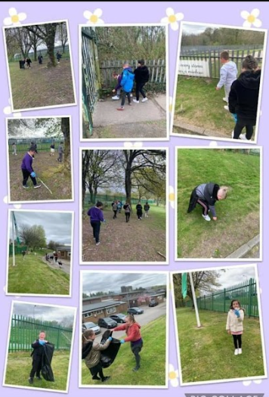
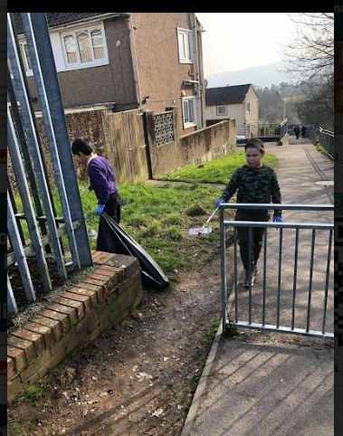

We are always looking for projects and opportunities to engage with the wider community…We have created educational leaflets and posters and have completed community cleans and litter picks. Our School do a number of things to support global goals.

Slide 8
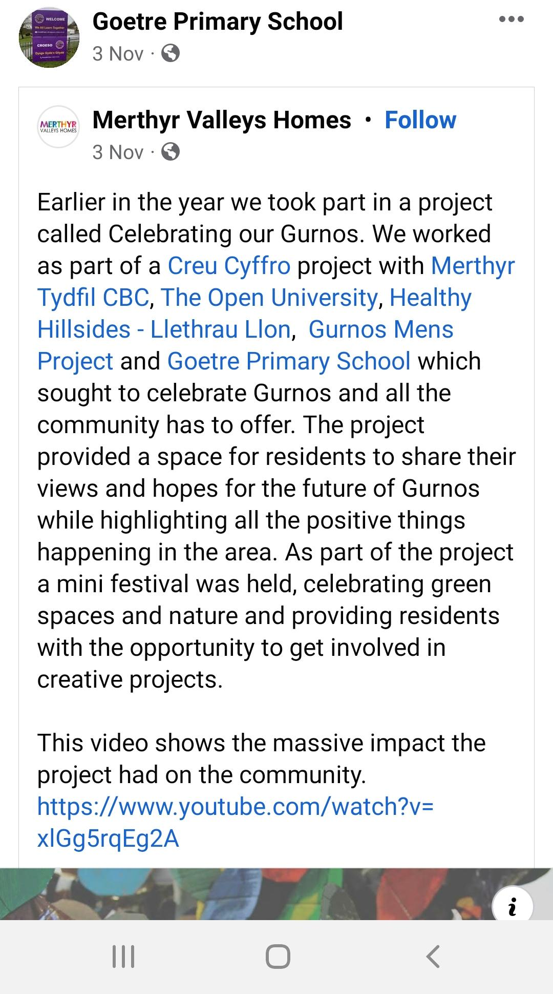
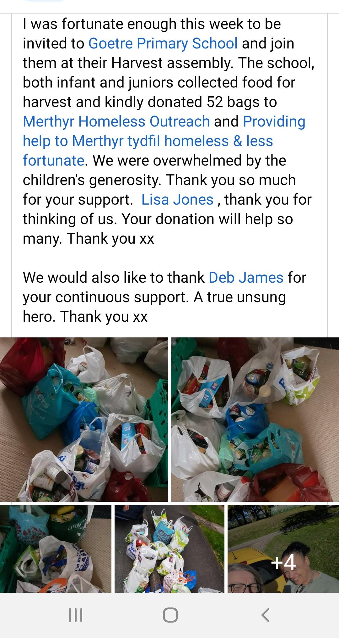
Examples of some of our Community Links this half term: We share and update our projects and successes via Class DOJO and our School Facebook Pages.

Slide 9
Quotes from our Teachers and Learners:
I love going to our fortnightly pupil voice groups. It’s a great time for us to discuss or eco targets and next steps. We share our ideas as a whole school. It’s nice to see the team mates from every different class in the school. My job is to meet with Mr Beech our Head Teacher then and share our initiatives and completed work to celebrate it.
Tori Lloyd (Chair, Year 5)
Being an eco-friendly citizen of the world means starting with your immediate environment, and home and school are the launching points. We take our roles as educators seriously. Even students who aren’t going green at home can learn some eco-friendly habits in the classroom and take them home to start making changes which will benefit not only our school but the wider community and world. Eco is a whole school approach and underpins our school ethos. My staff strive, at every appropriate opportunity to create eco-friendly projects for our students, and we aim to create environmentally-friendly adults down the road. R. Bennett (Assistant Head)
I am extremely proud of our pupils and the enthusiasm they show during every eco meeting. Eco is a passion of mine due to my farming background and agricultural hobbies. It's been a challenging time for us maneuvering through a global pandemic but we are excited to now get our team back together in the same classroom and getting busy! We have already made great progress this term and I look forward to another fantastic year of Eco again in 22/23!
Miss Evans (Eco Co-Ordinator)

Slide 10
Line of Enquiry- How Can we Sustain our Eco club during a Global Pandemic?
2021- As a school we have had to change our approach to eco schools during the past year, as we have been unable to conduct our usual weekly meetings because children were unable to mix groups and phases due to covid19 and the spread of the virus and were confined to class ’bubbles’. We decided to run a range of eco competitions and calendar events for all classes to take part in. We set research tasks and learning experiences throughout the school to meet all areas of ECO with lots of them being set as online tasks during lockdown. Some of the children’s home school tasks included bird watching in their garden and creating recycled bird feeders. Researching the impact of litter and plastic on the environment and marine life. The impact of climate change, and the conservation of endangered animals.
September 2022- We are excited to start the new academic year by getting all of our old processes back up and running post Covid. We are excited about collaborating as a whole school approach again and now run fortnightly pupil voice meetings which take place every Friday afternoon. The children have worked hard during these meetings to create an updated audit and action plan for us to work on collaboratively over the forthcoming months. To date, we have met five times as an ECO team this half term. We have held a whole school assembly to remind pupils of our expectations and goals. We have developed our school environment with new classroom recycling bins and bins around the school yards. We have met with a community project who have built us large wooden planters to develop our outside eco school area. This will be our key priority after Christmas. We aim to build big huts, recycled bird feeders and plant flowers to bring wildlife. We are also aiming to get a chicken coop built to get new school pets.

Slide 11
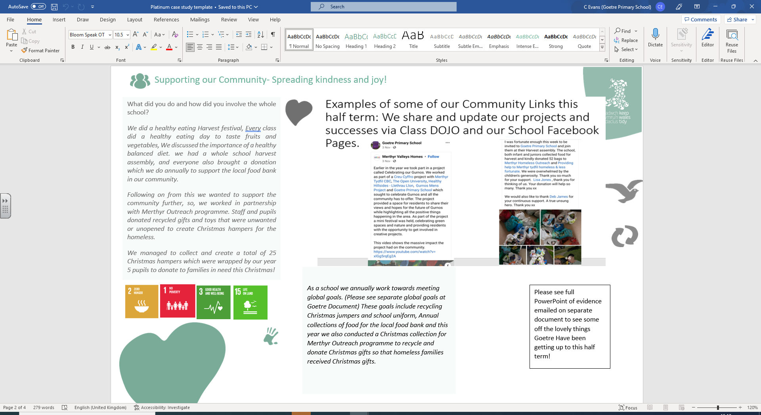

Eco Committee Actions Autumn Term 22

